Slide 1

Final Presentation
Module: C5: Visual Recognition
Group: 7
Students: Cristian Gutiérrez
Iñaki Lacunza
Marco Cordón
Merlès Subirà

Slide 2
Index
Summary of previous weeks.
Week 6: Multimodal Human Analysis
Different sets statistics
Define a classifier with image only and evaluate
Define a train strategy
Define a test strategy
Define a strategy to represent acoustic data
Define a strategy to represent text data
Multimodal model
Ablation study
Conclusions

Slide 3


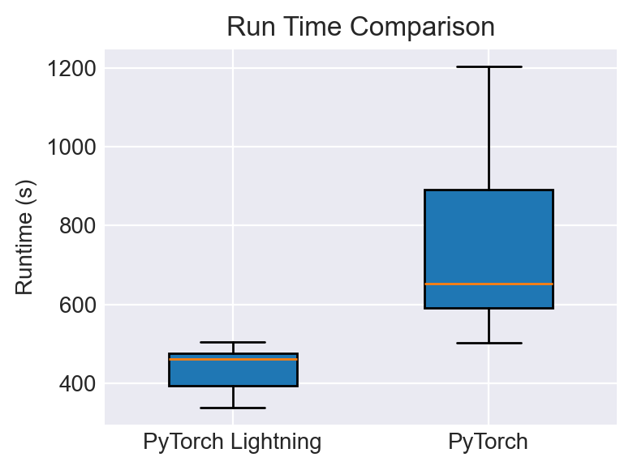
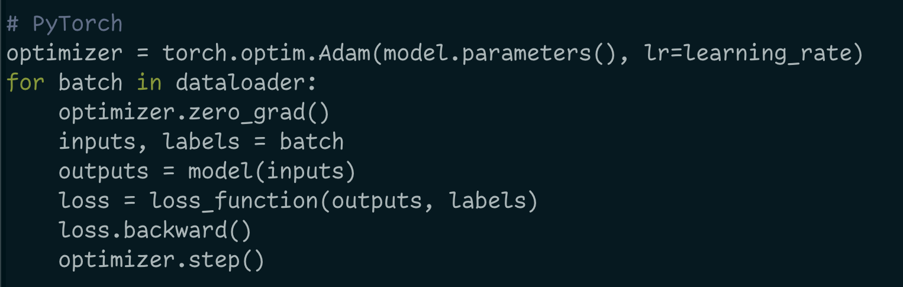
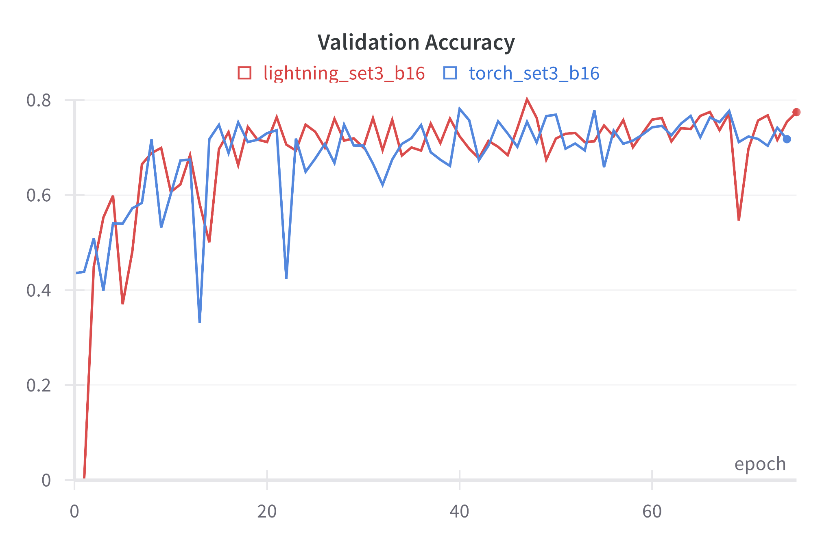
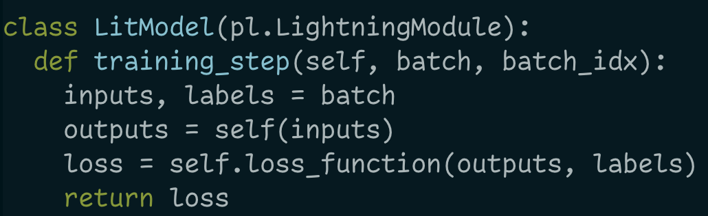
Week 1: Comparing modules
VS
Results
Performance
Code
Lightning achieved slightly better results than PyTorch
12 Runs for each framework
Avg
PyTorch lets you code
Lightning has a convention
Best Val
80.16%
77.84%
7.23 mins
12.49 mins
Both achieve similar results
Lightning is faster Lightning is more stable
PyTorch is more flexible
Lightning is more opinionated

Slide 4
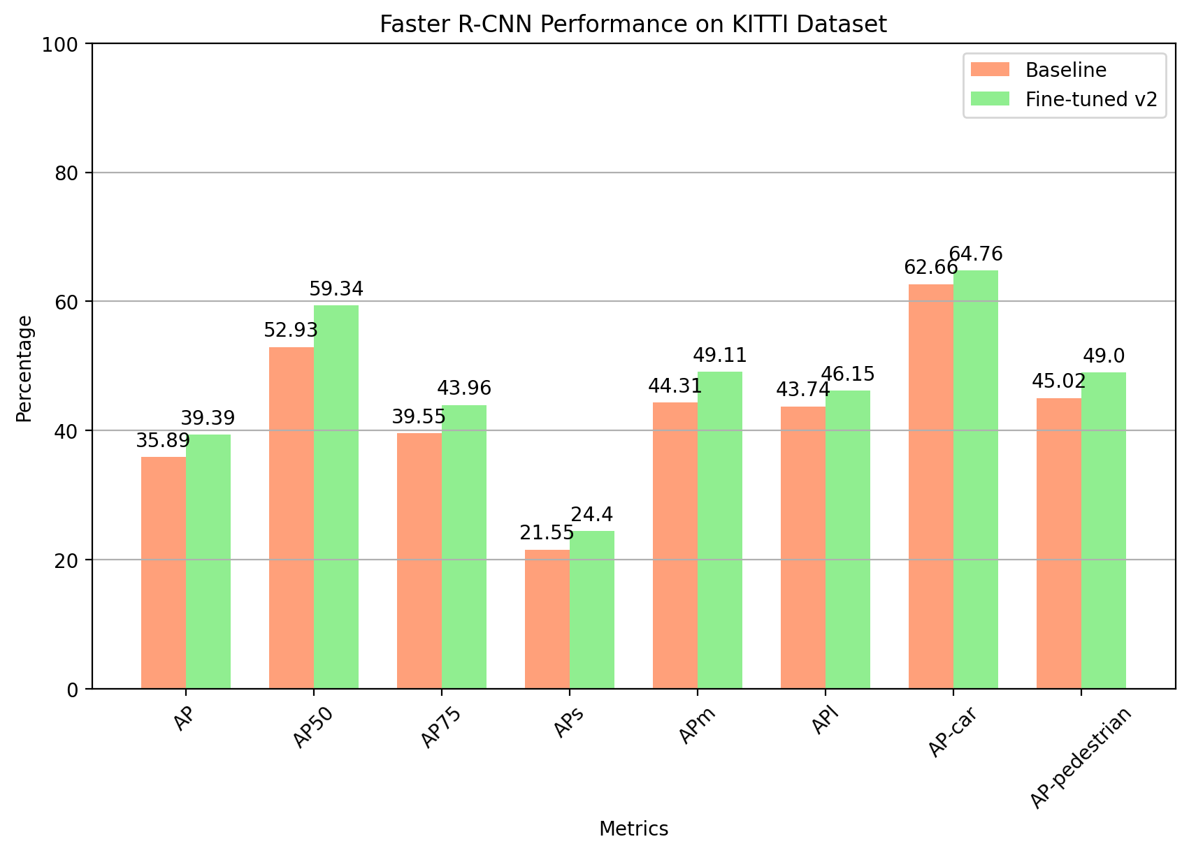
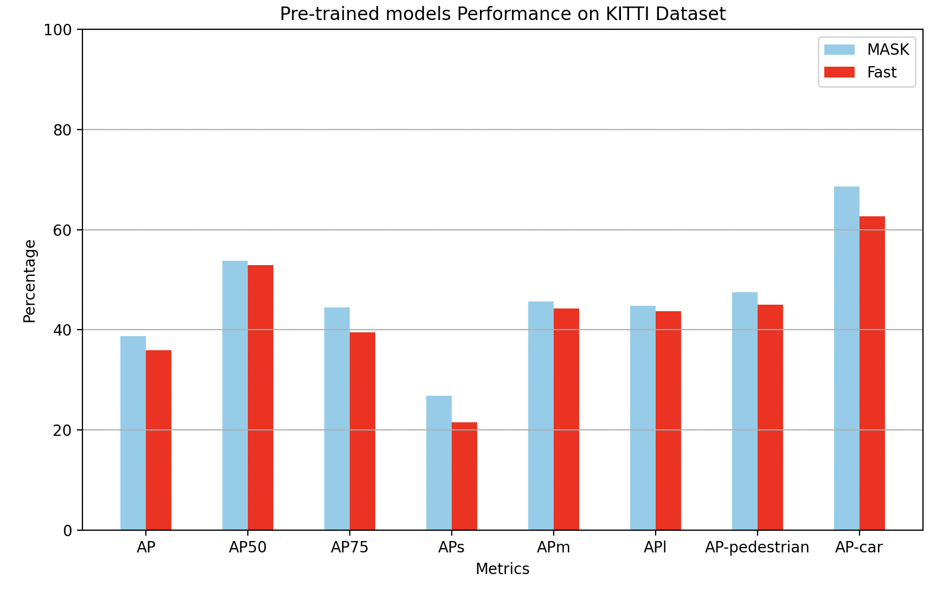
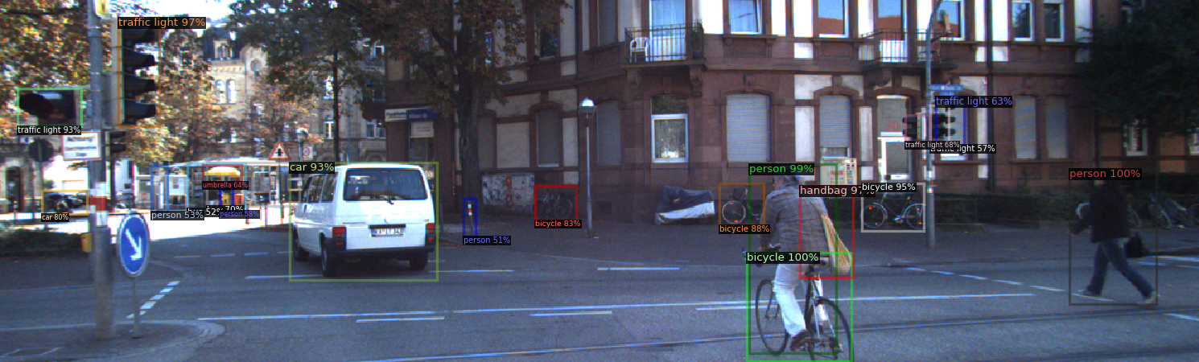
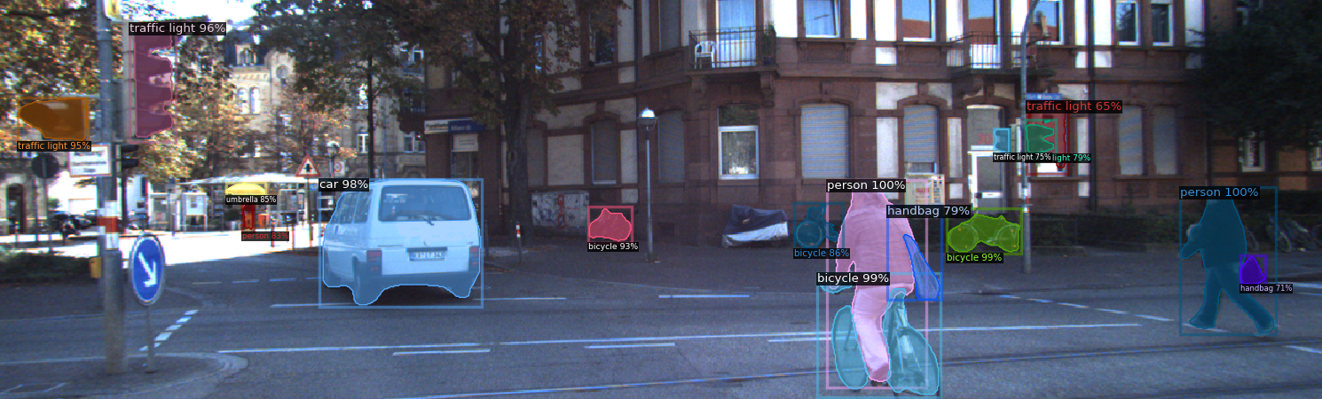
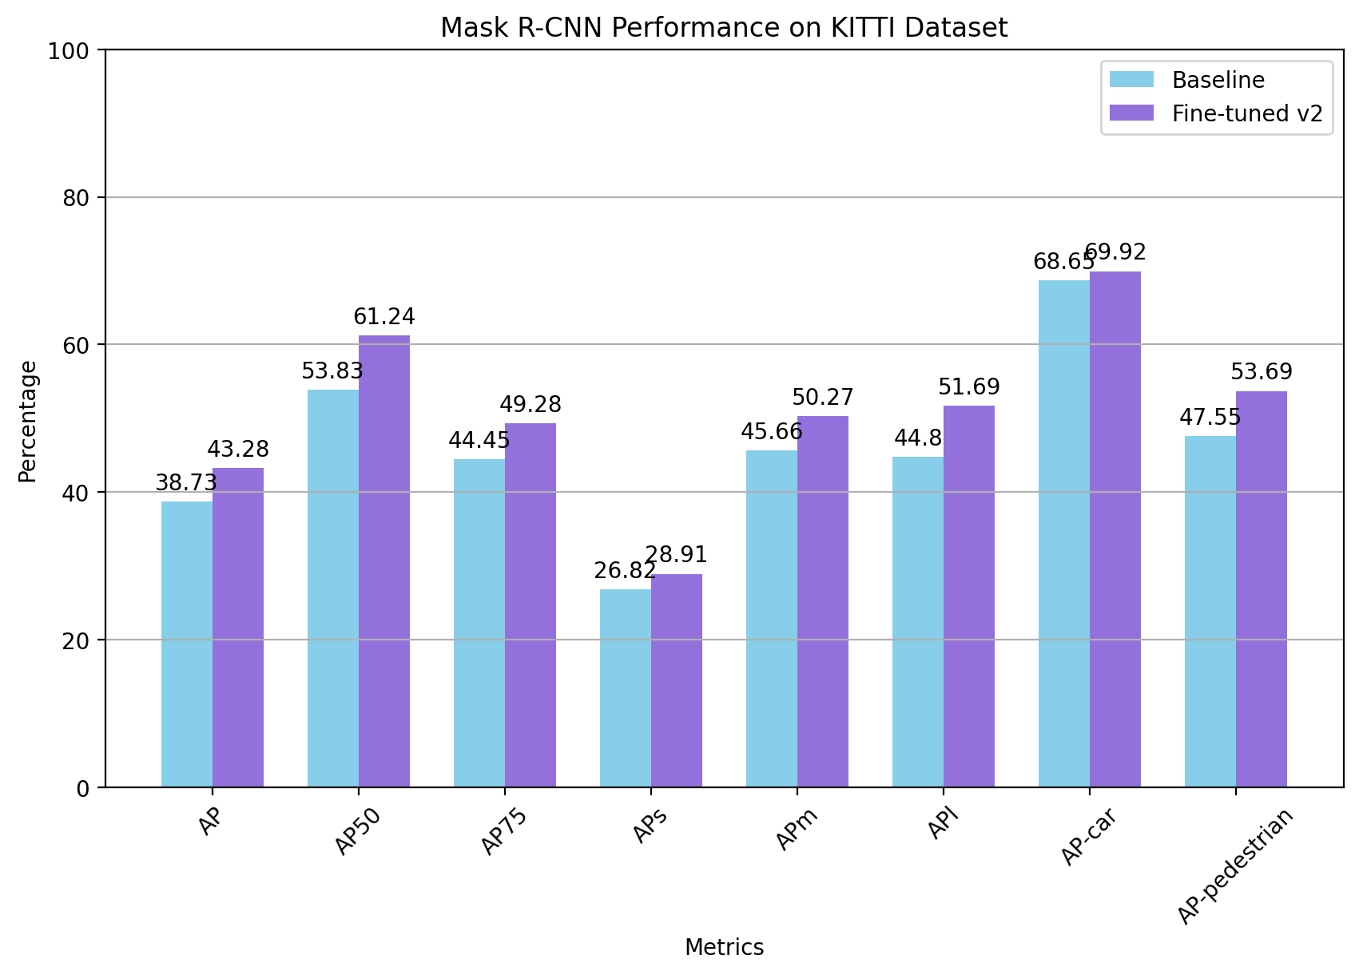
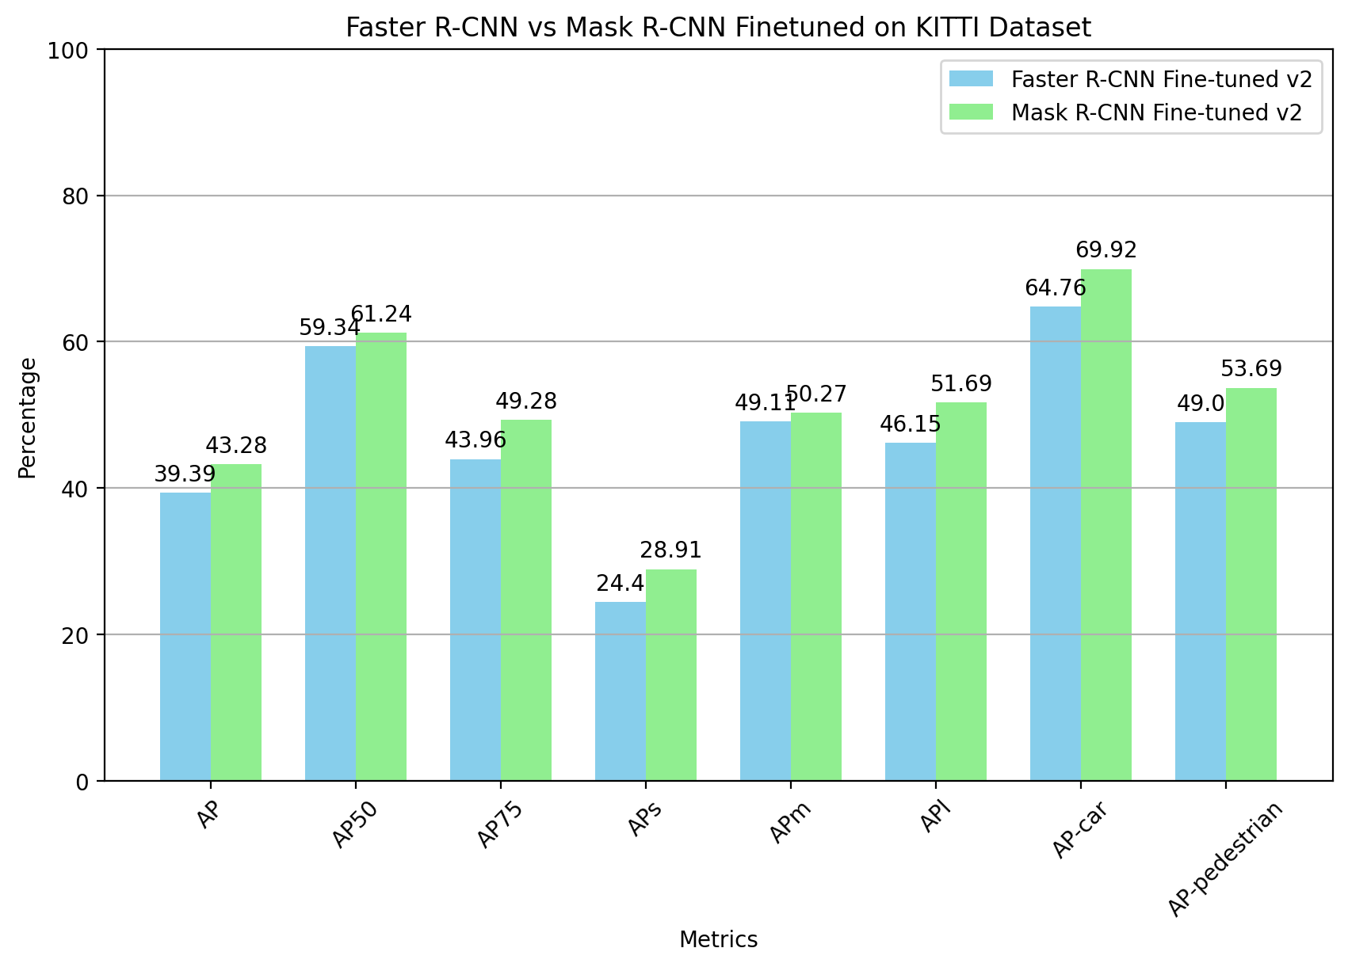
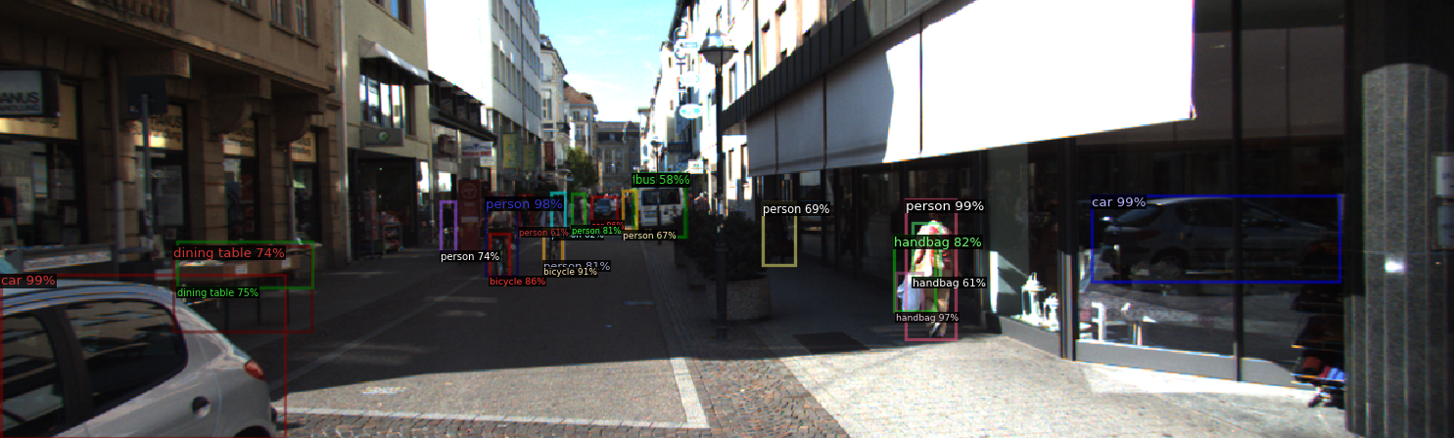
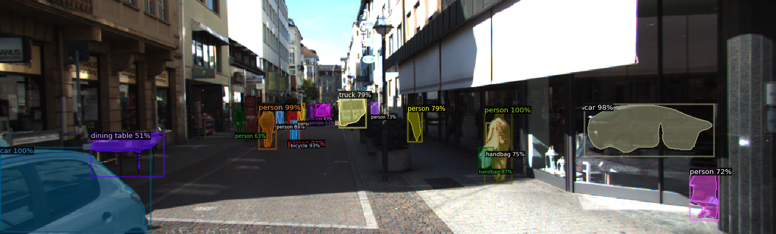
Week 2: Object detection and segmentation
Pre-trained vs fine-tuned
Faster vs Mask
Qualitatively
Faster R-CNN
Mask R-CNN
❌
✅
✅
✅

Slide 5
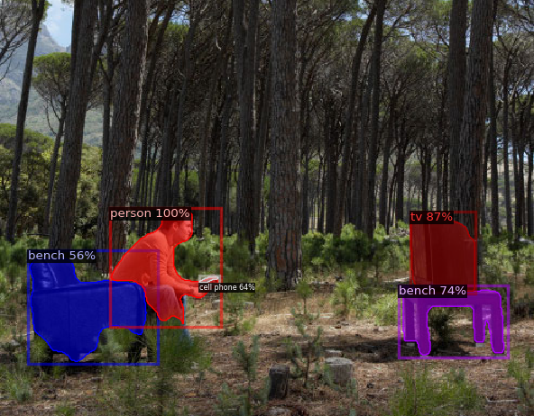
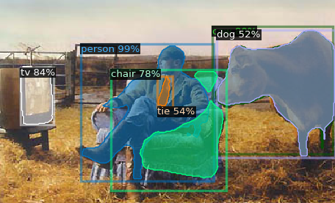
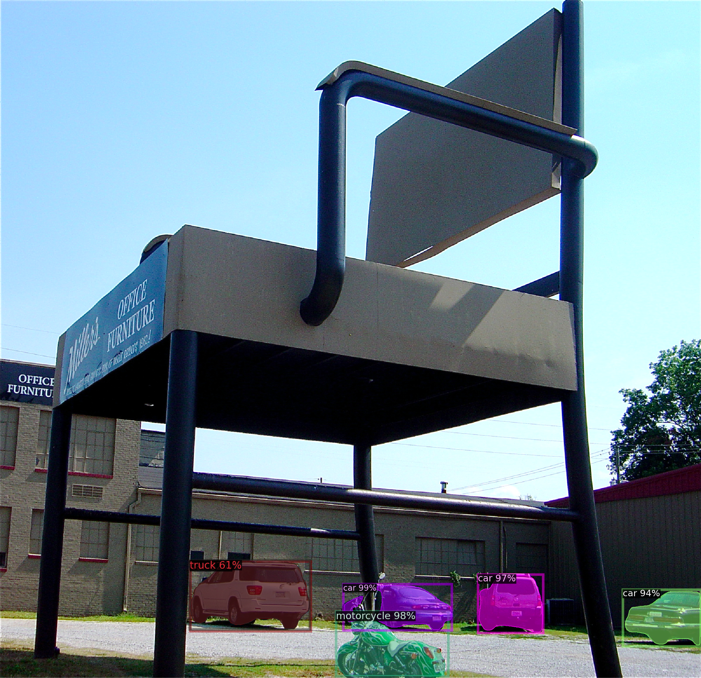
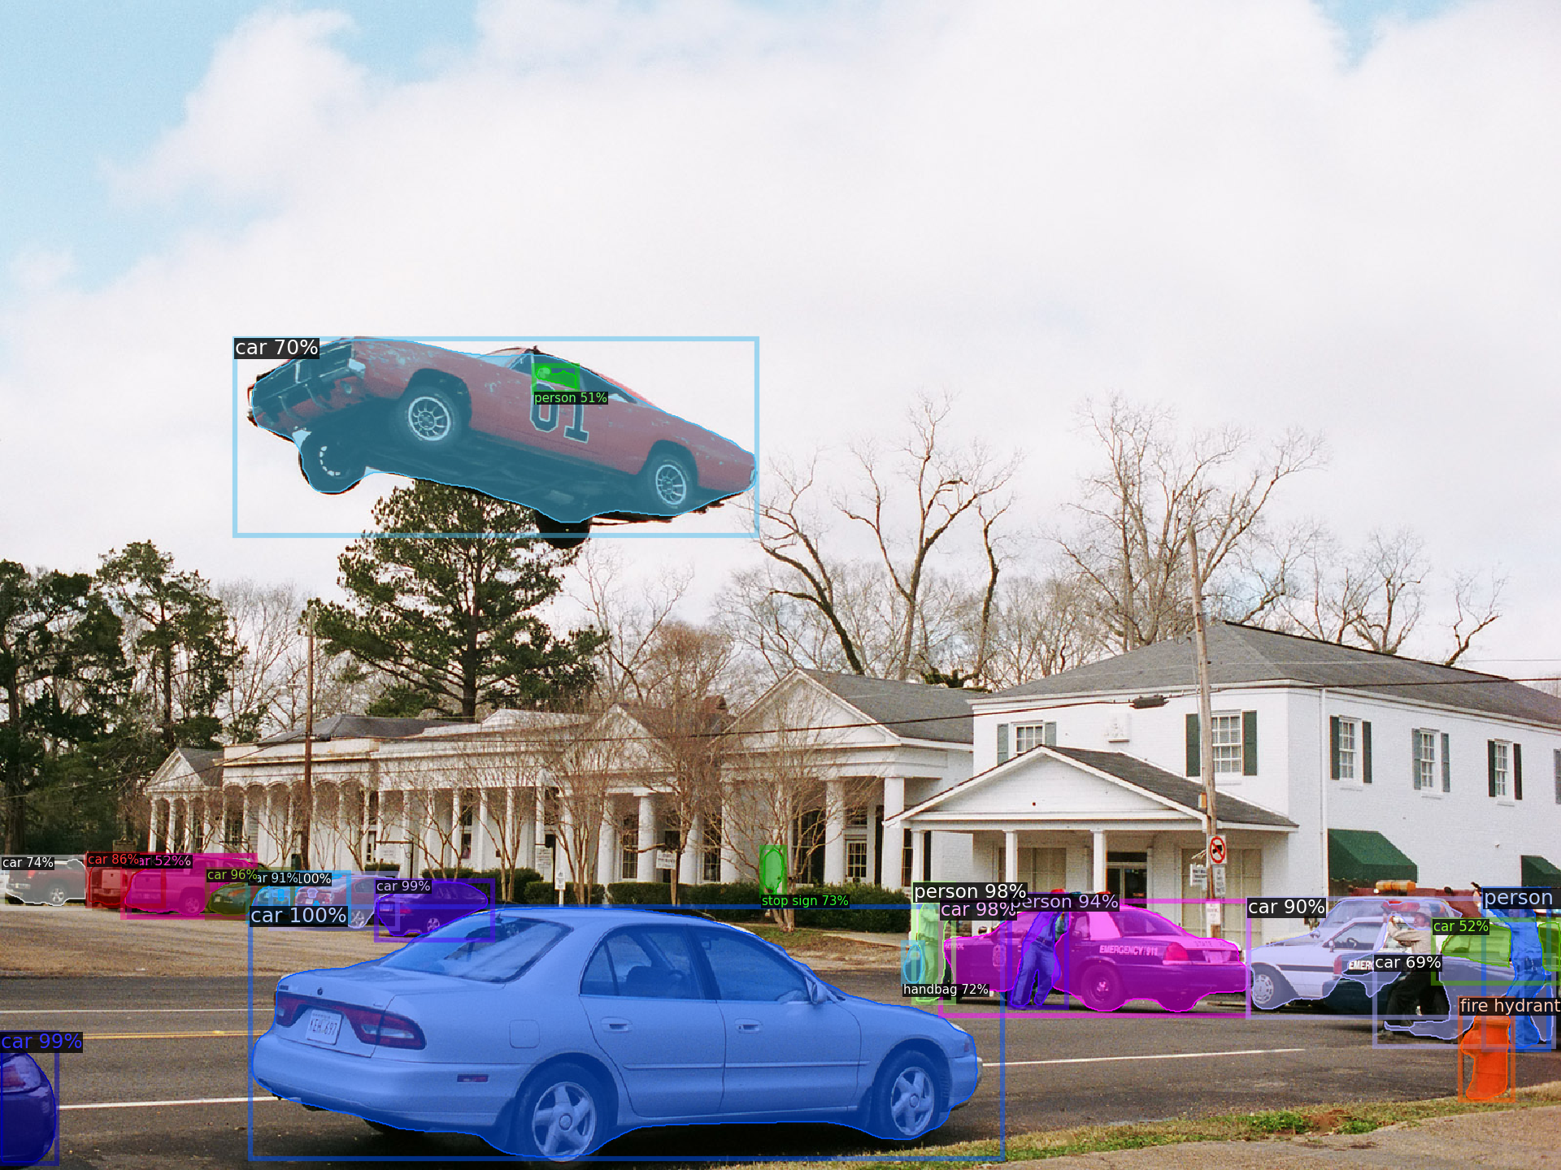
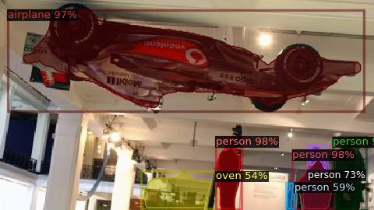
Week 2: Out of context object recognition
Case 1: Well classified but low score
Case 2: Wrongly classified
Case 3: not detected
Chair??

Slide 6
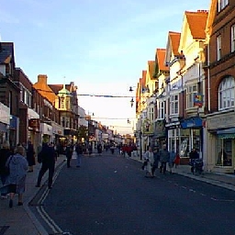
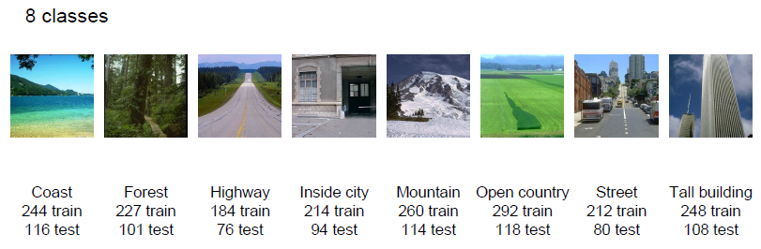
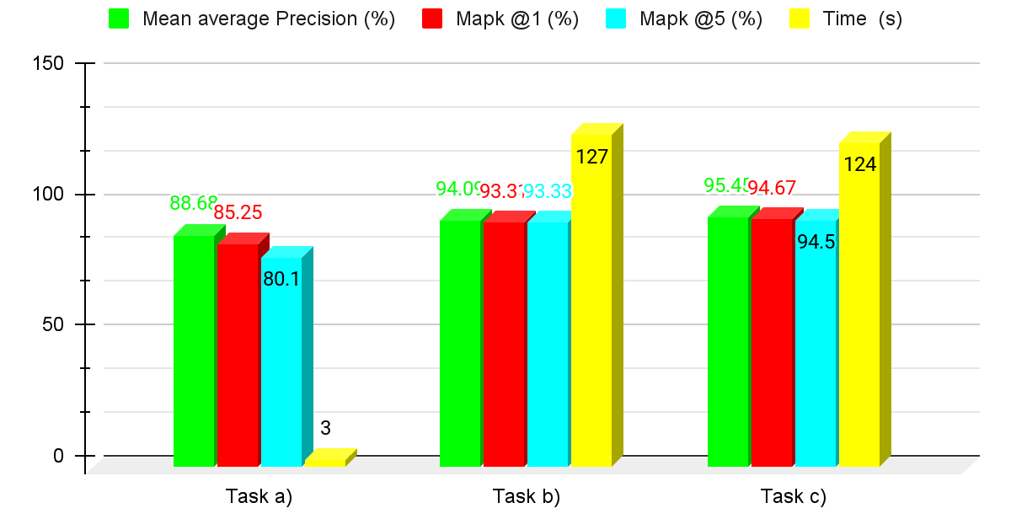
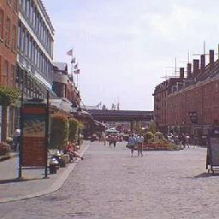
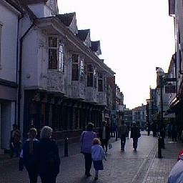
Week 3: Image retrieval with metric learning
Query image: street
MIT_SPLIT dataset
ResNet-18
Score and time comparison for:
a) ResNet-18. b) Siamese network. c) Triplet network.
Retrieved images and distance (euclidean):
a) 11.55
b) 5.87
c) 5.87
a) 11.99
b) 6.73
c) 3.45

Slide 7
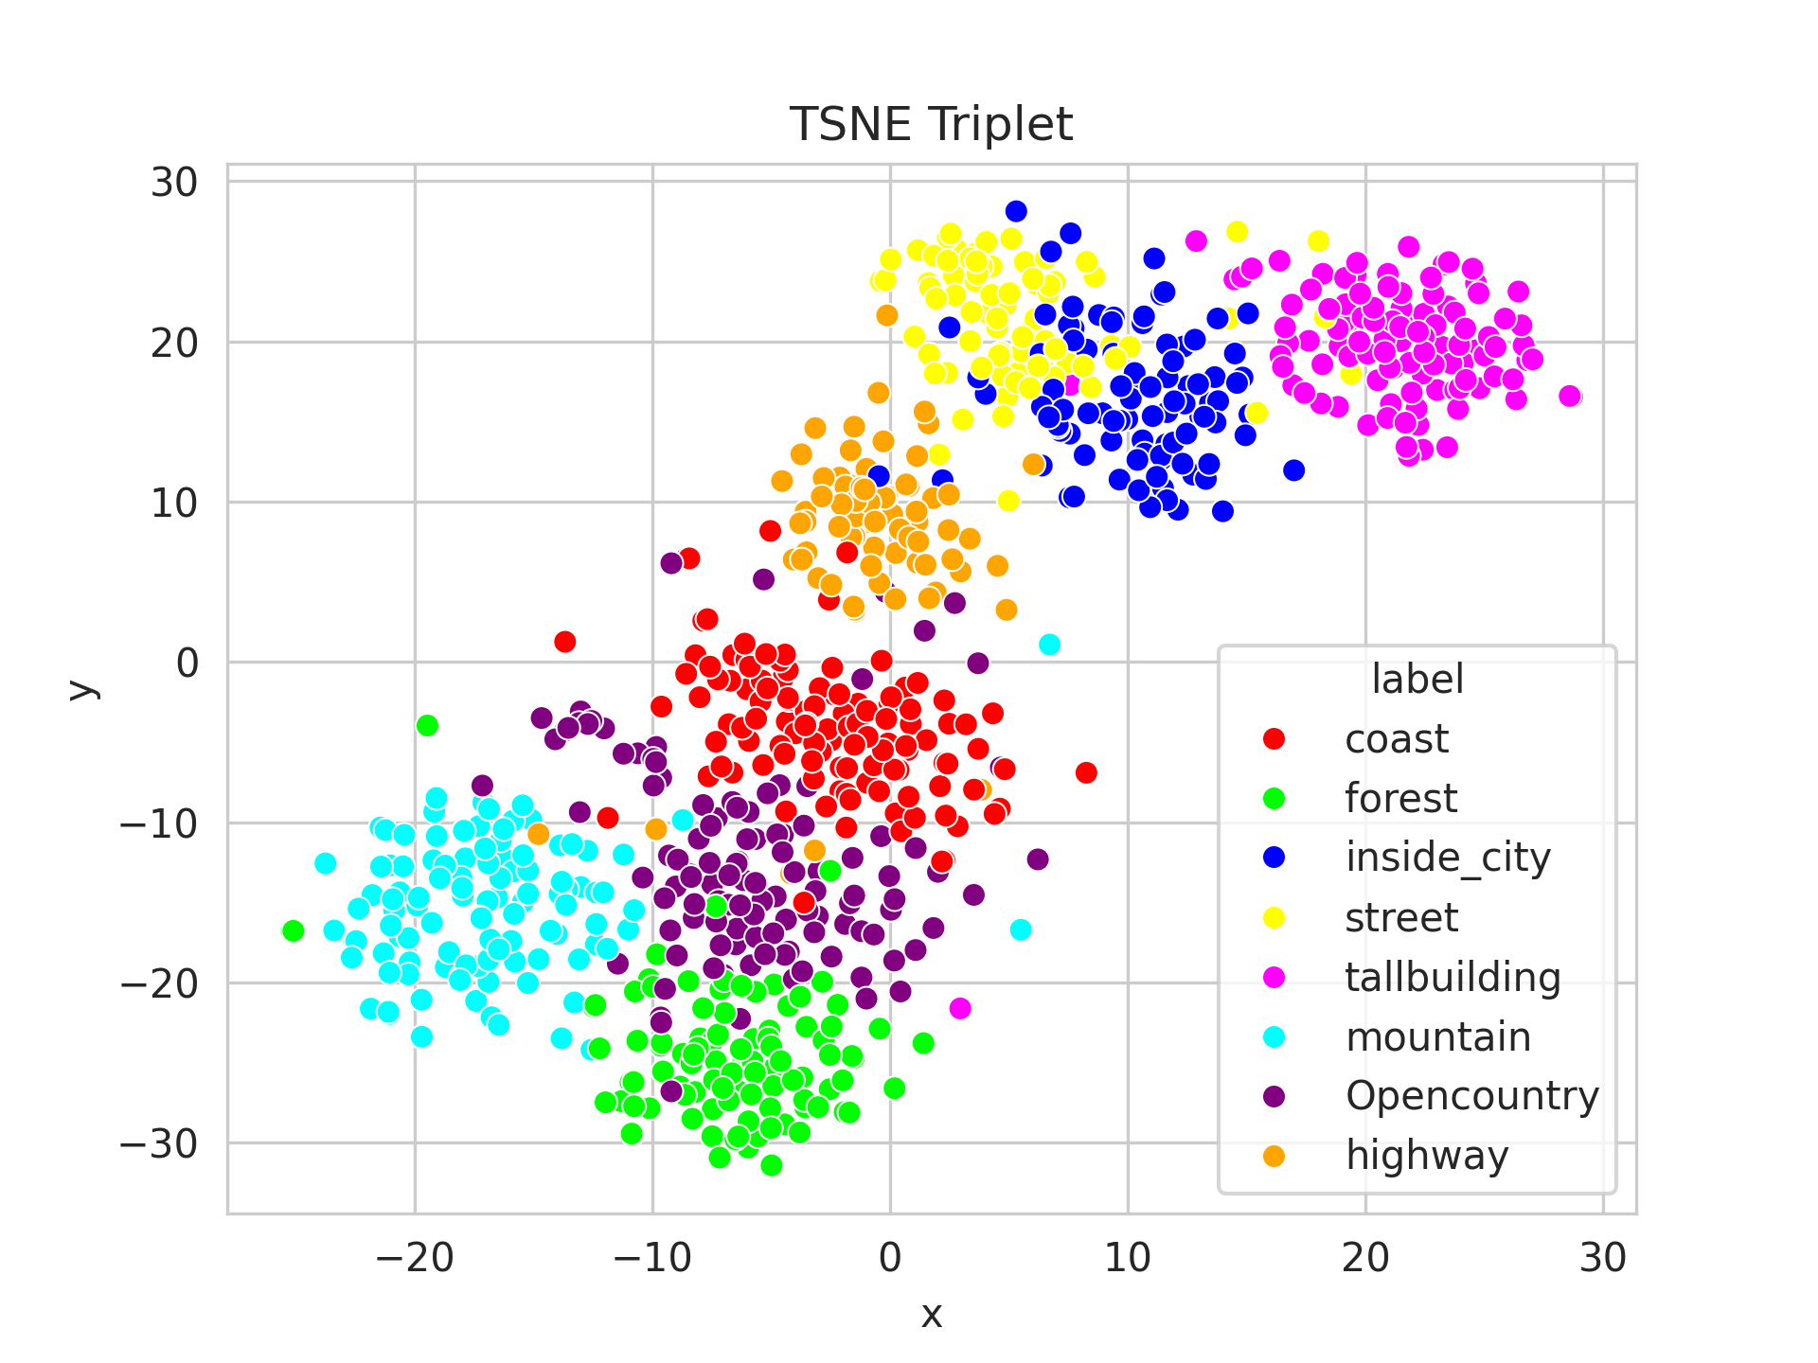
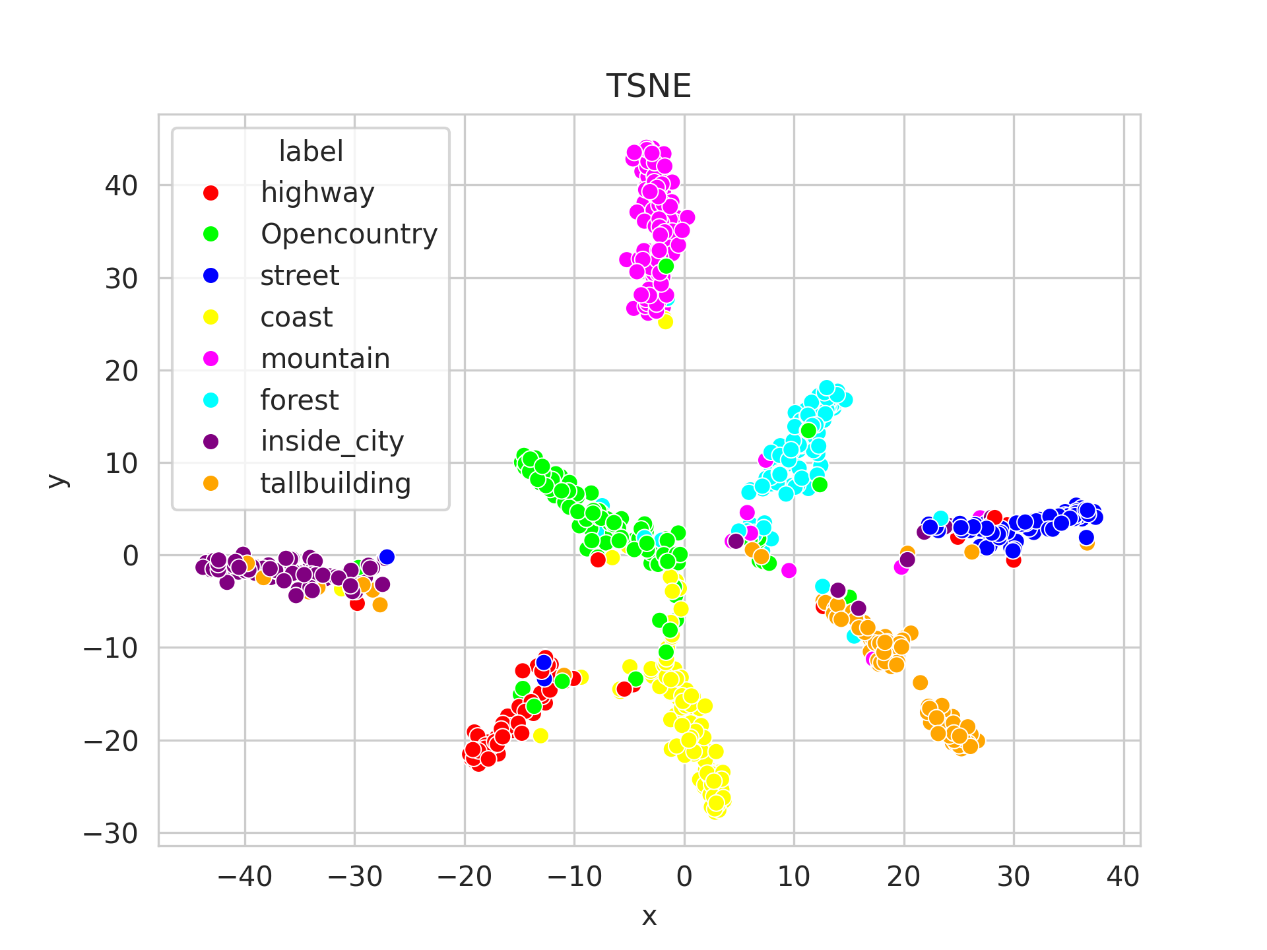
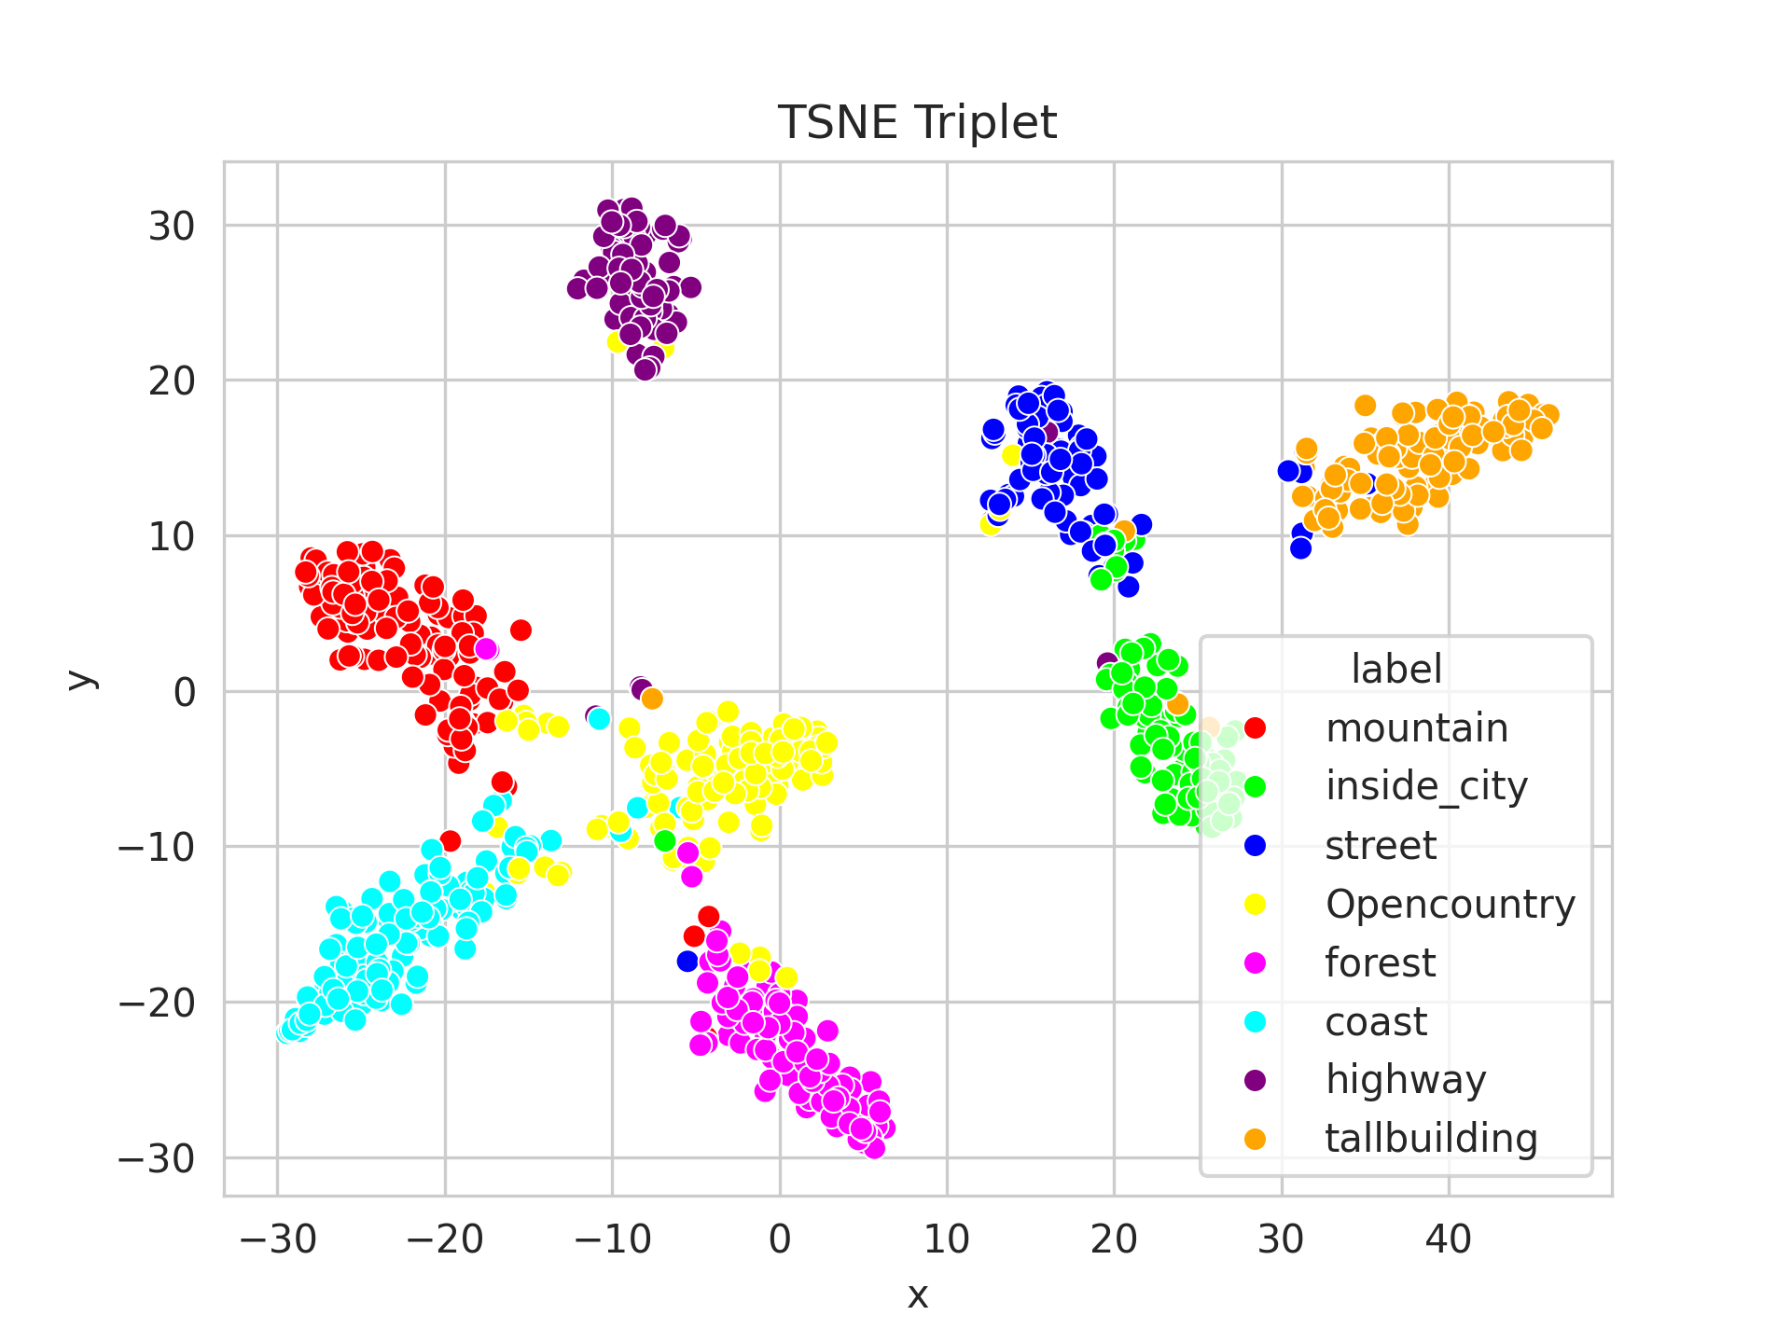
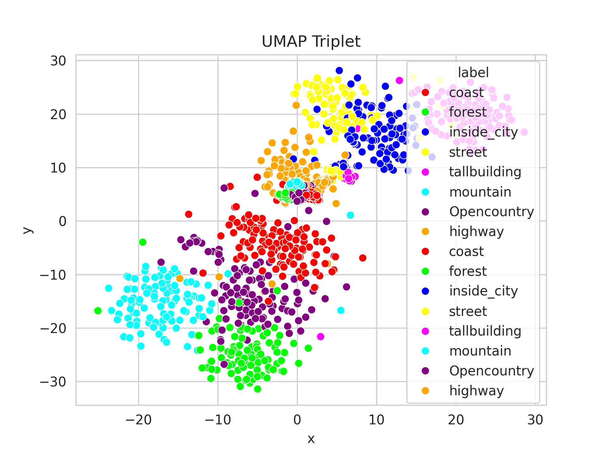
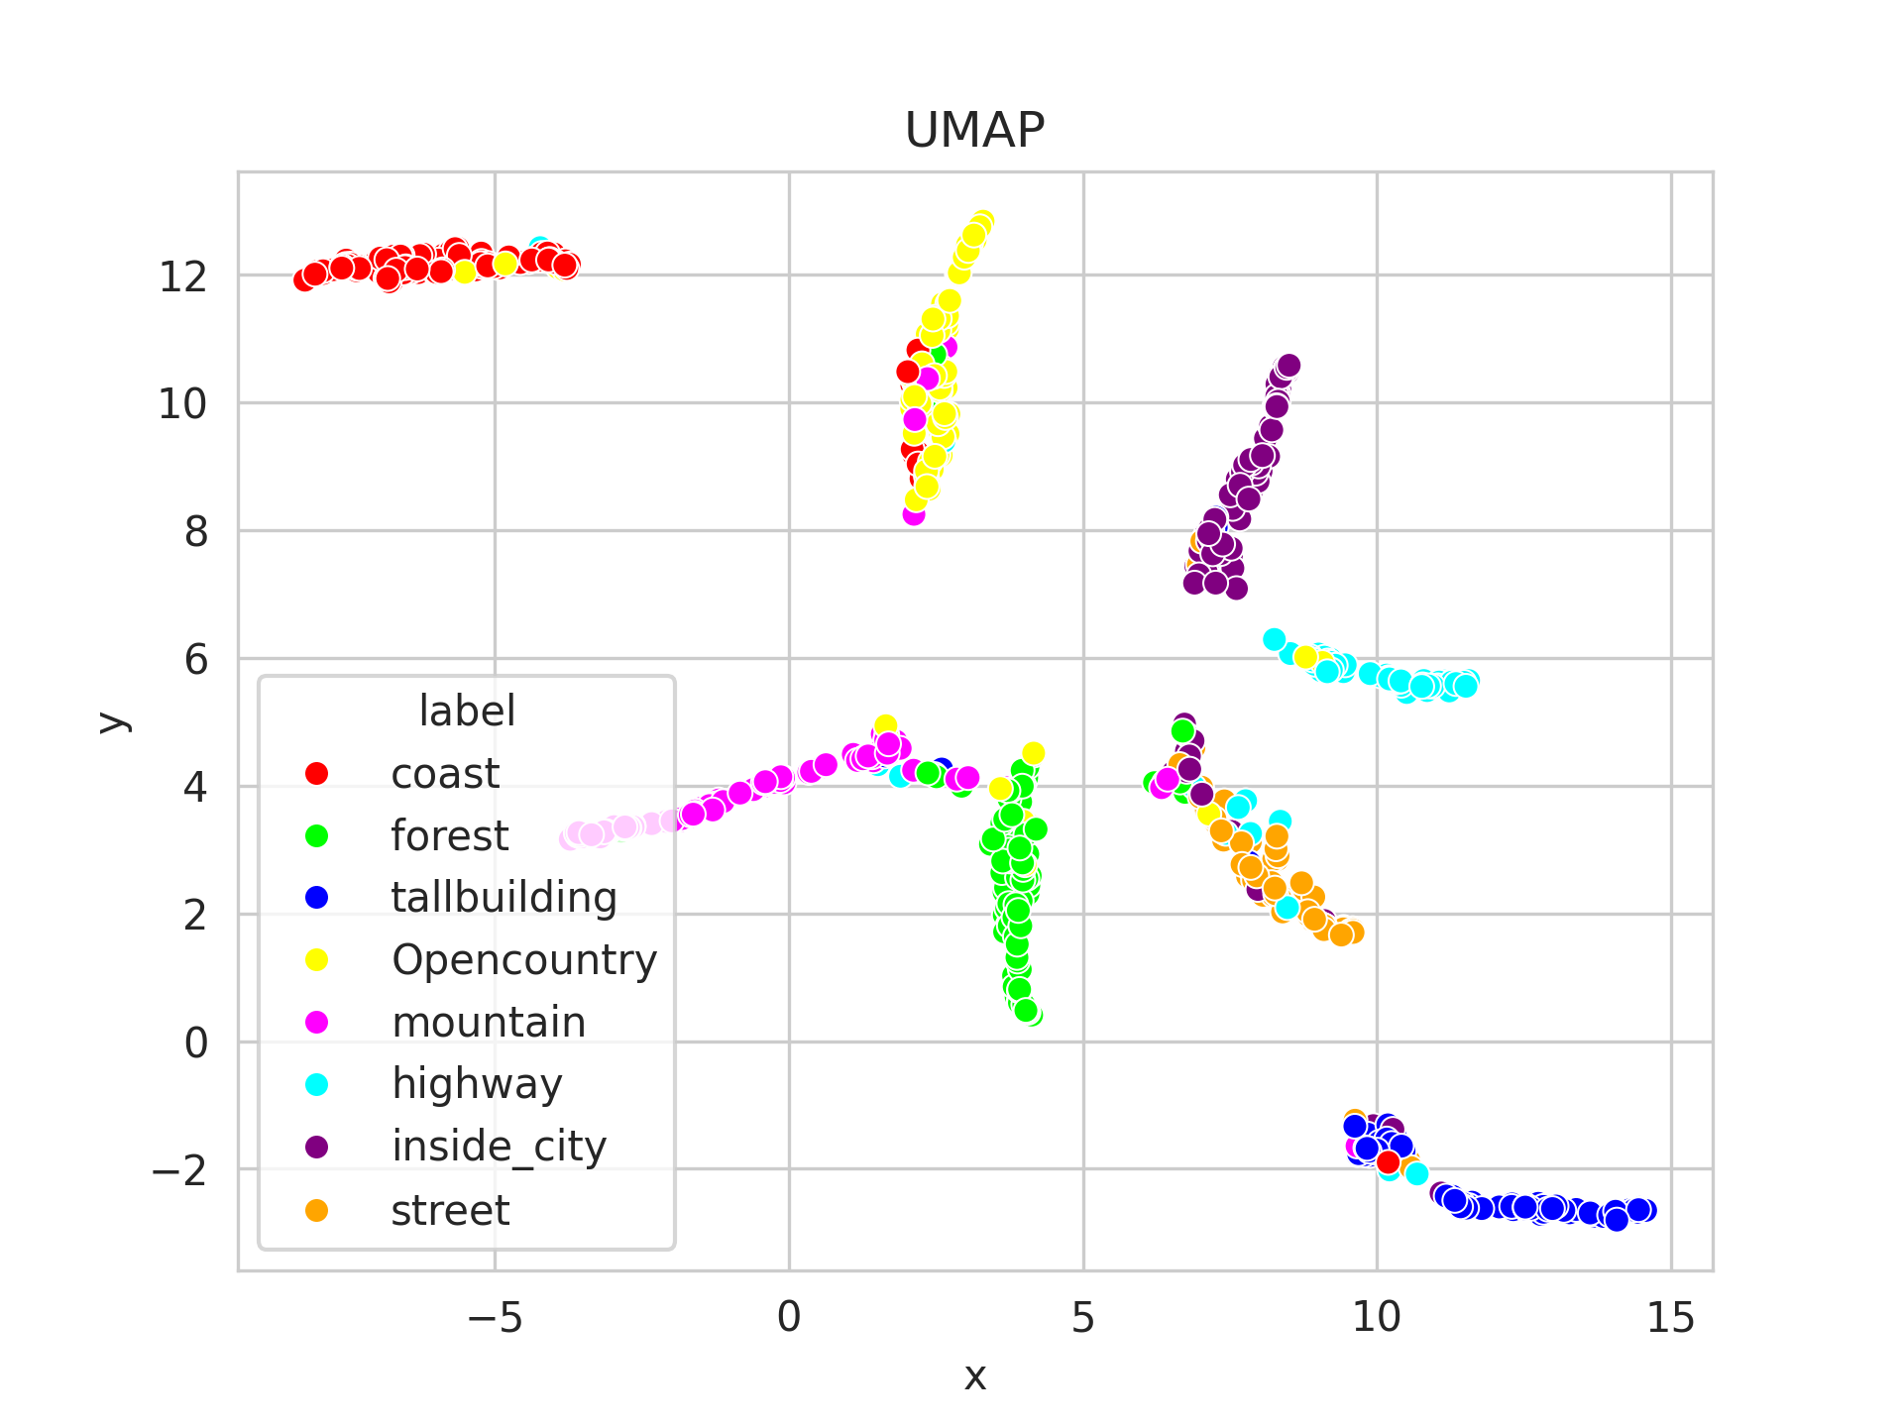
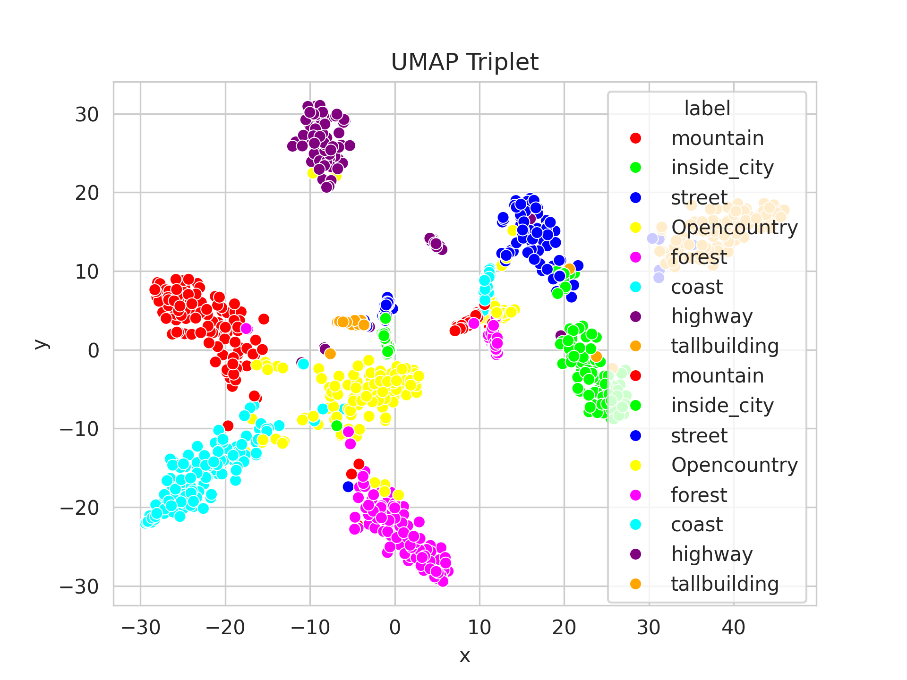
Week 3: Image retrieval with metric learning
Task a
Task b
Task c
TSNE
Task a
Task b
Task c
Umap

Slide 8
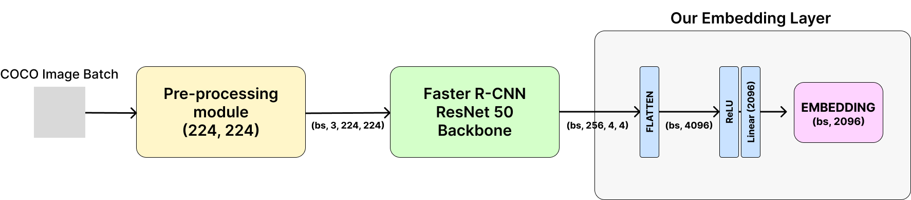
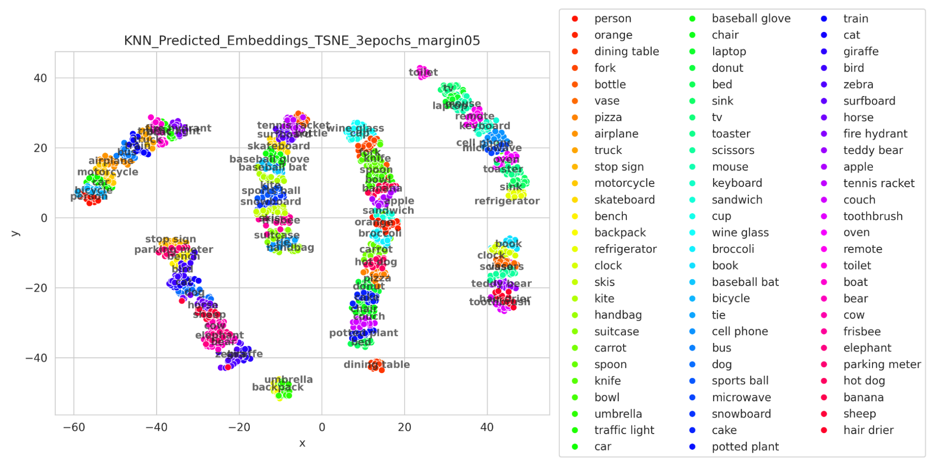
Week 3: Image retrieval with metric learning
Built a 1:1 dataset.
Offline hard-mining.
Time: 5h.
Image Retrieval on COCO with Faster R-CNN. Val. accuracy: 97.65%. Total run time: 6h 30min.
Found super classes:
LIVING AND TRANSPORT
(person, truck, motorcycle…)
FOOD AND KITCHEN
(i.e. broccoli, knife, spoon…)
SPORT ACTIVITIES AND MISC
(skateboard, baseball bat, skis…)
ELECTRONICS
(i.e. keyboard, cell phone…)
COMMON UTILITIES
(i.e. book, scissors, toothbrush…)
ANIMALS AND URBAN
(i.e. elephant, dog, stop sign…)

Slide 9
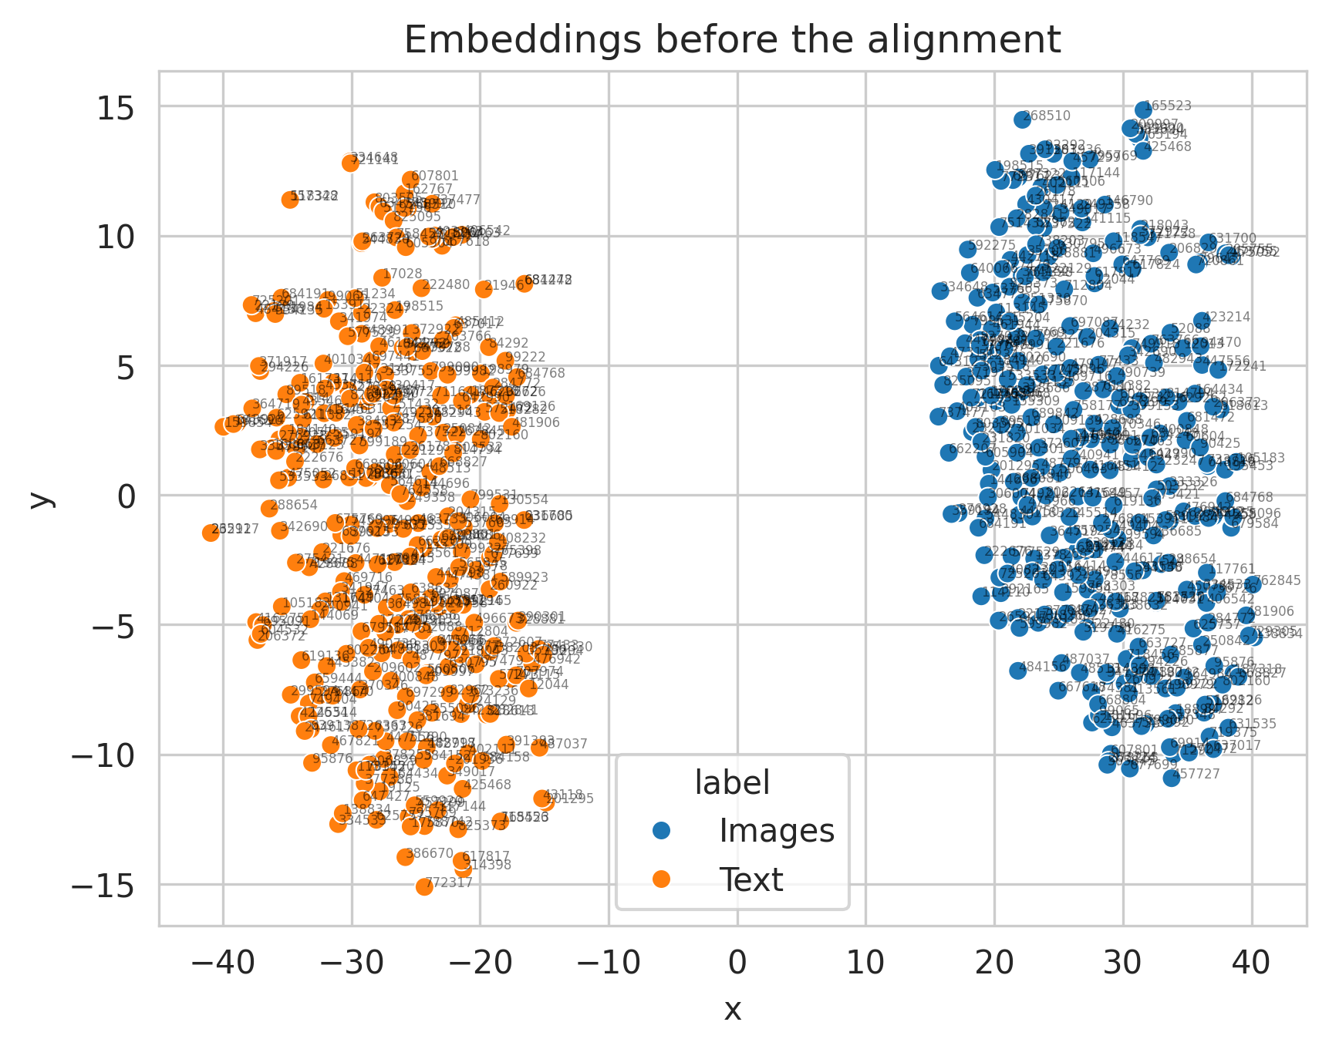
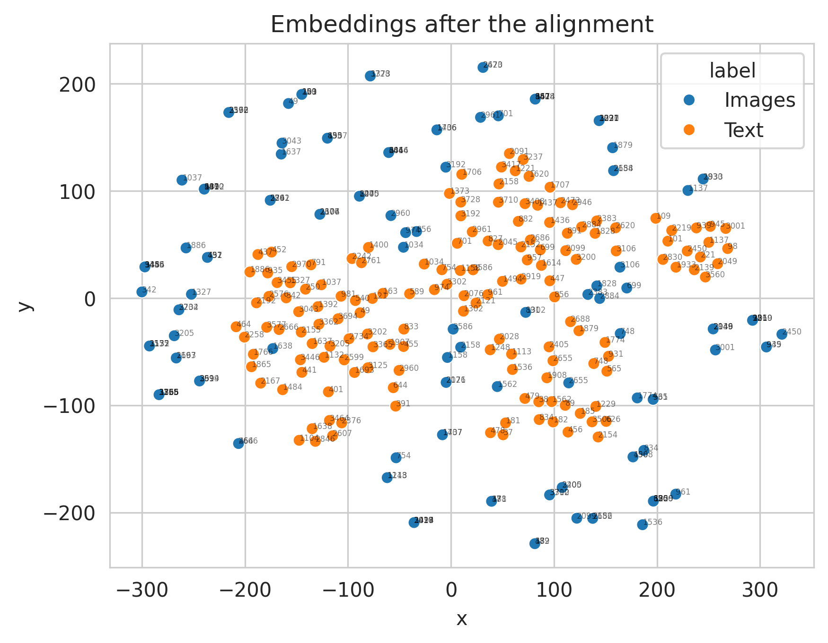

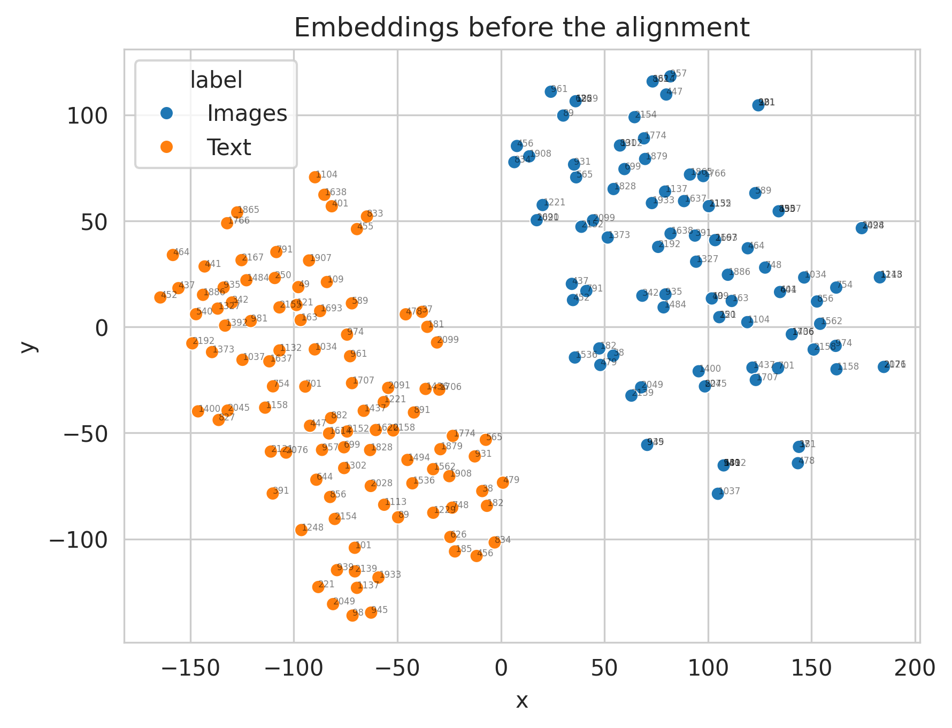
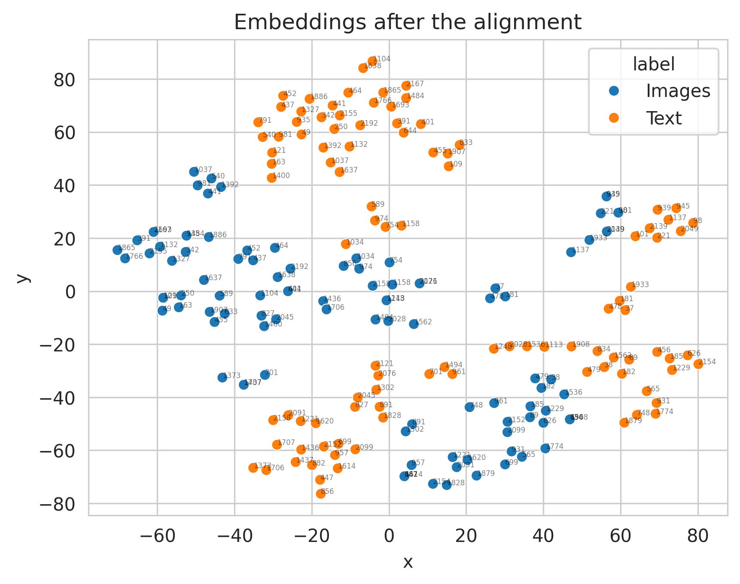
Week 4: Cross-Modal Retrieval: Image to text
Train time: 14:57h, using a RTX 3090.
Final loss value: 0.079.
Image to text
Train time: 13:32h, using a RTX 3090.
Final loss value: 0.075.
Text to image
(100 instances picked randomly)

Slide 10
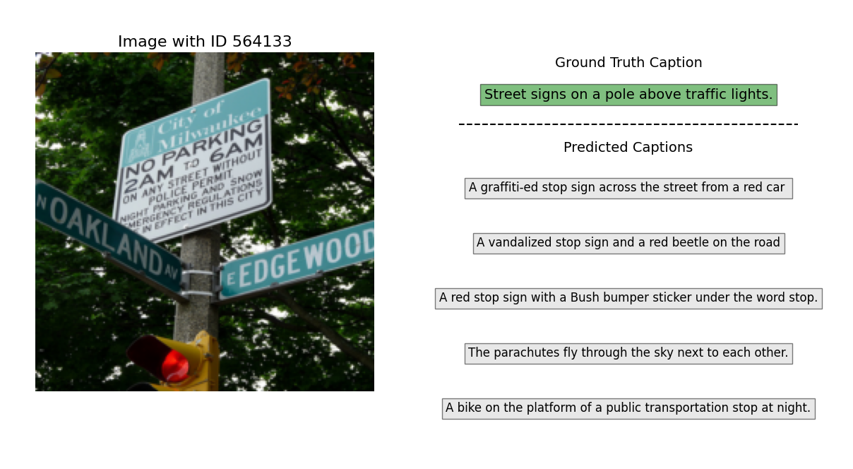
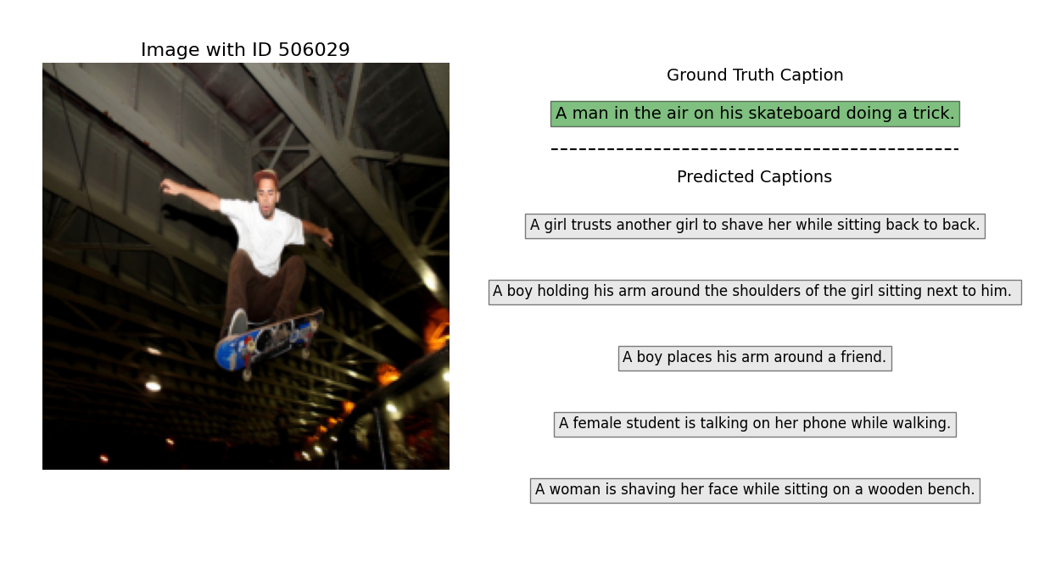
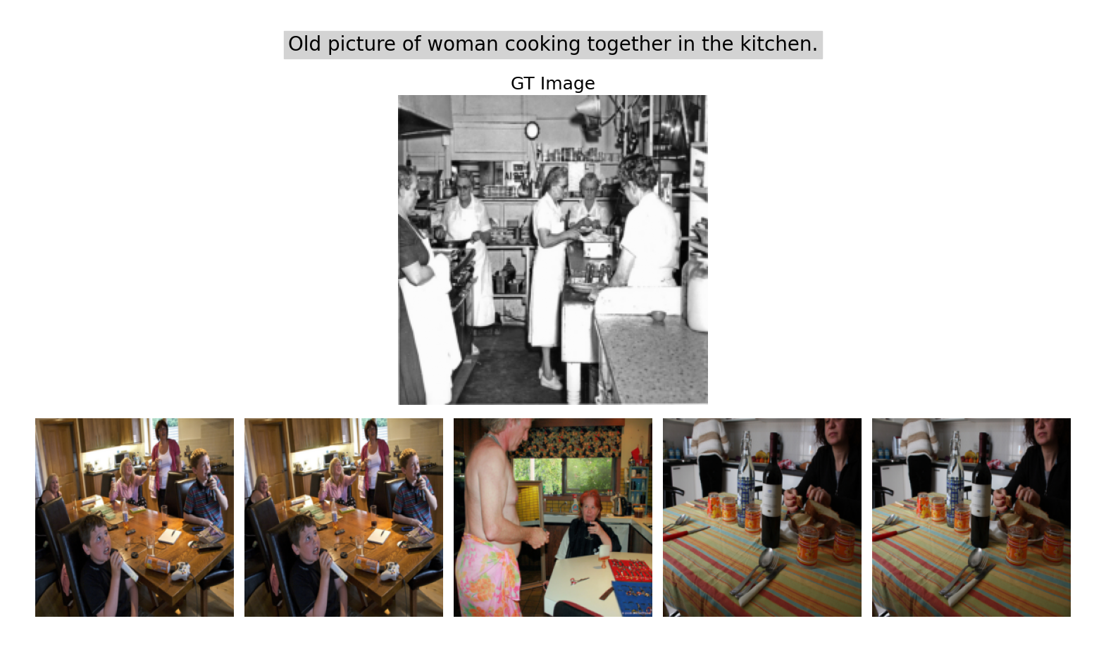
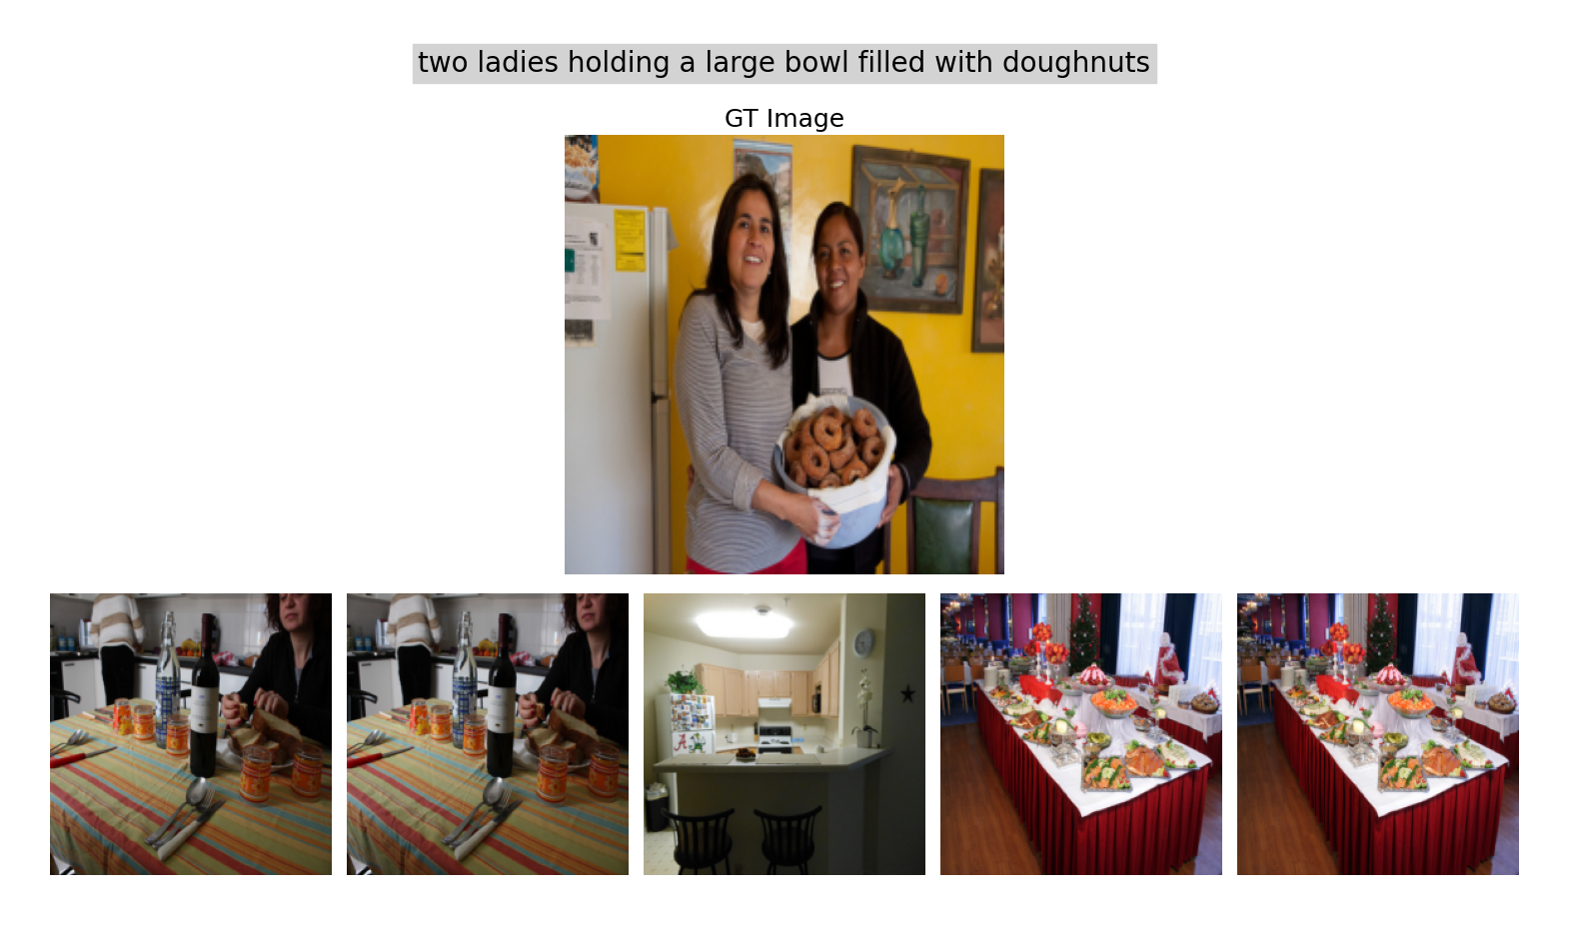
Week 4: Cross-Modal Retrieval: Image to text
Image to text
Text to image

Slide 11
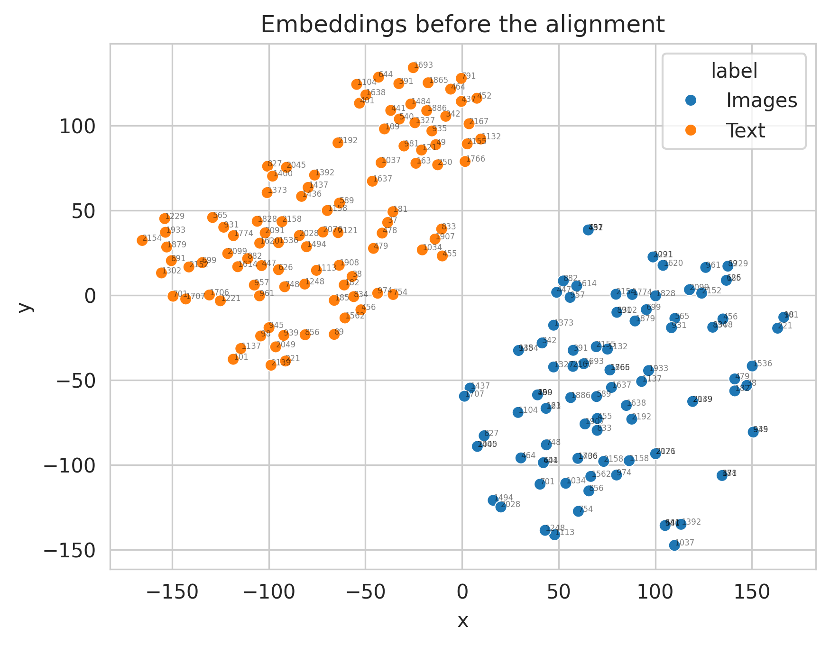
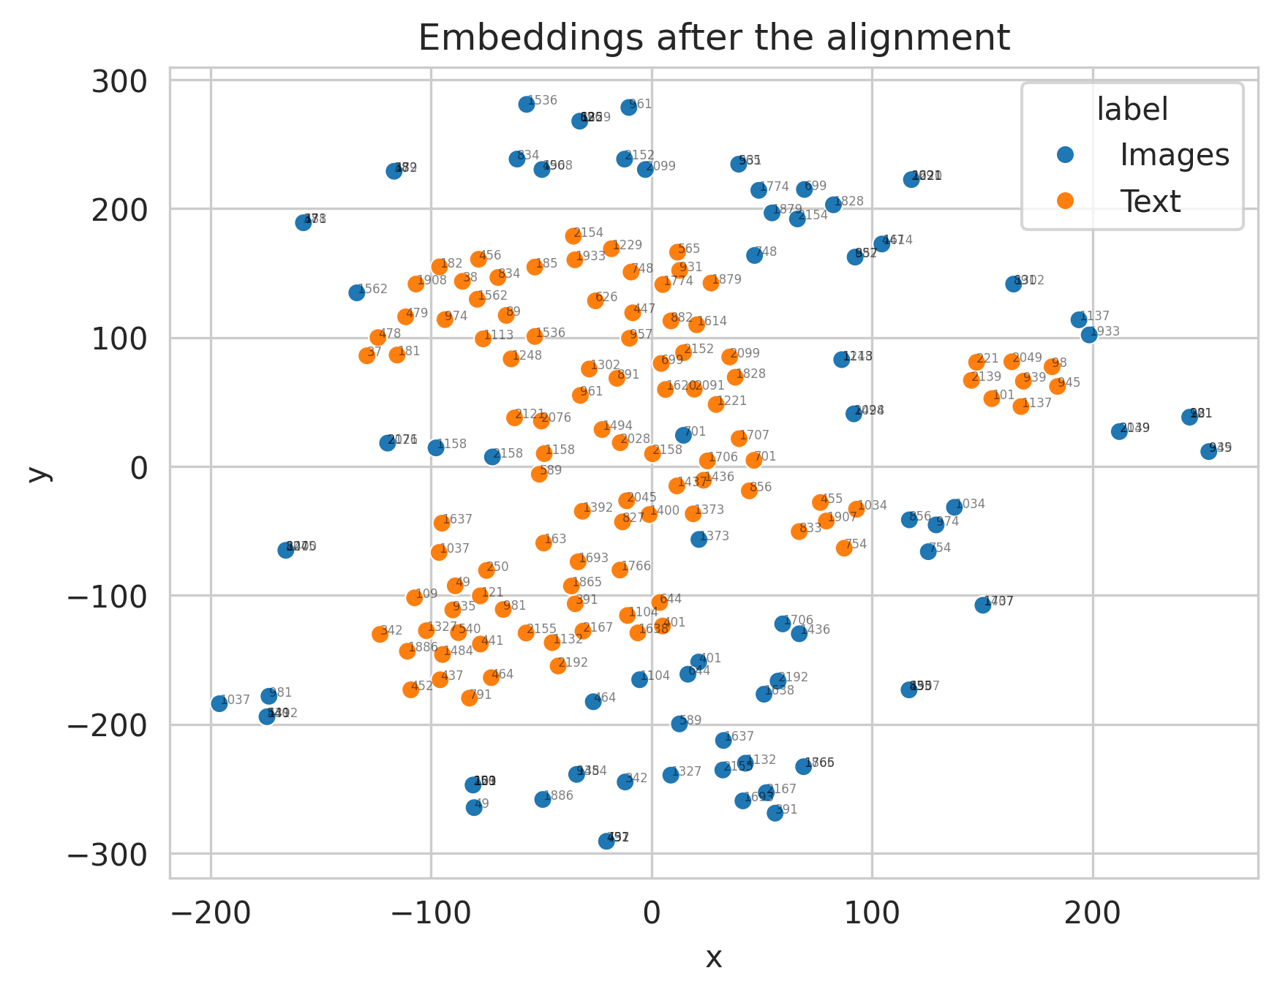
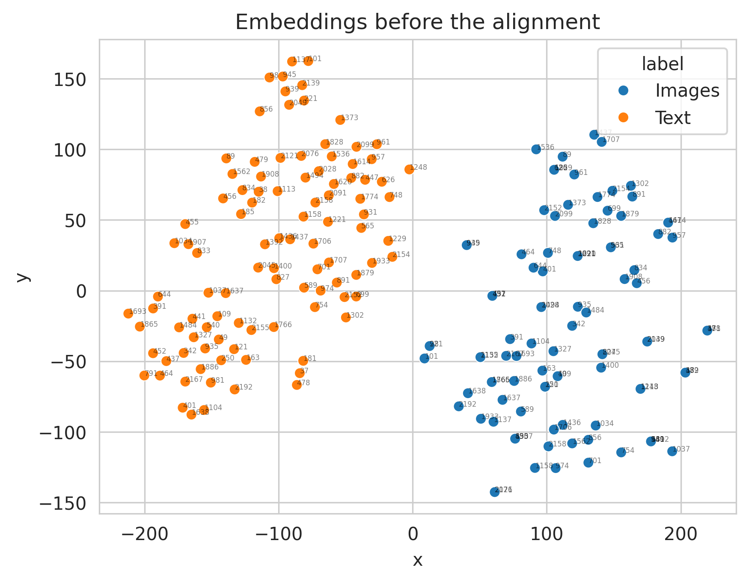
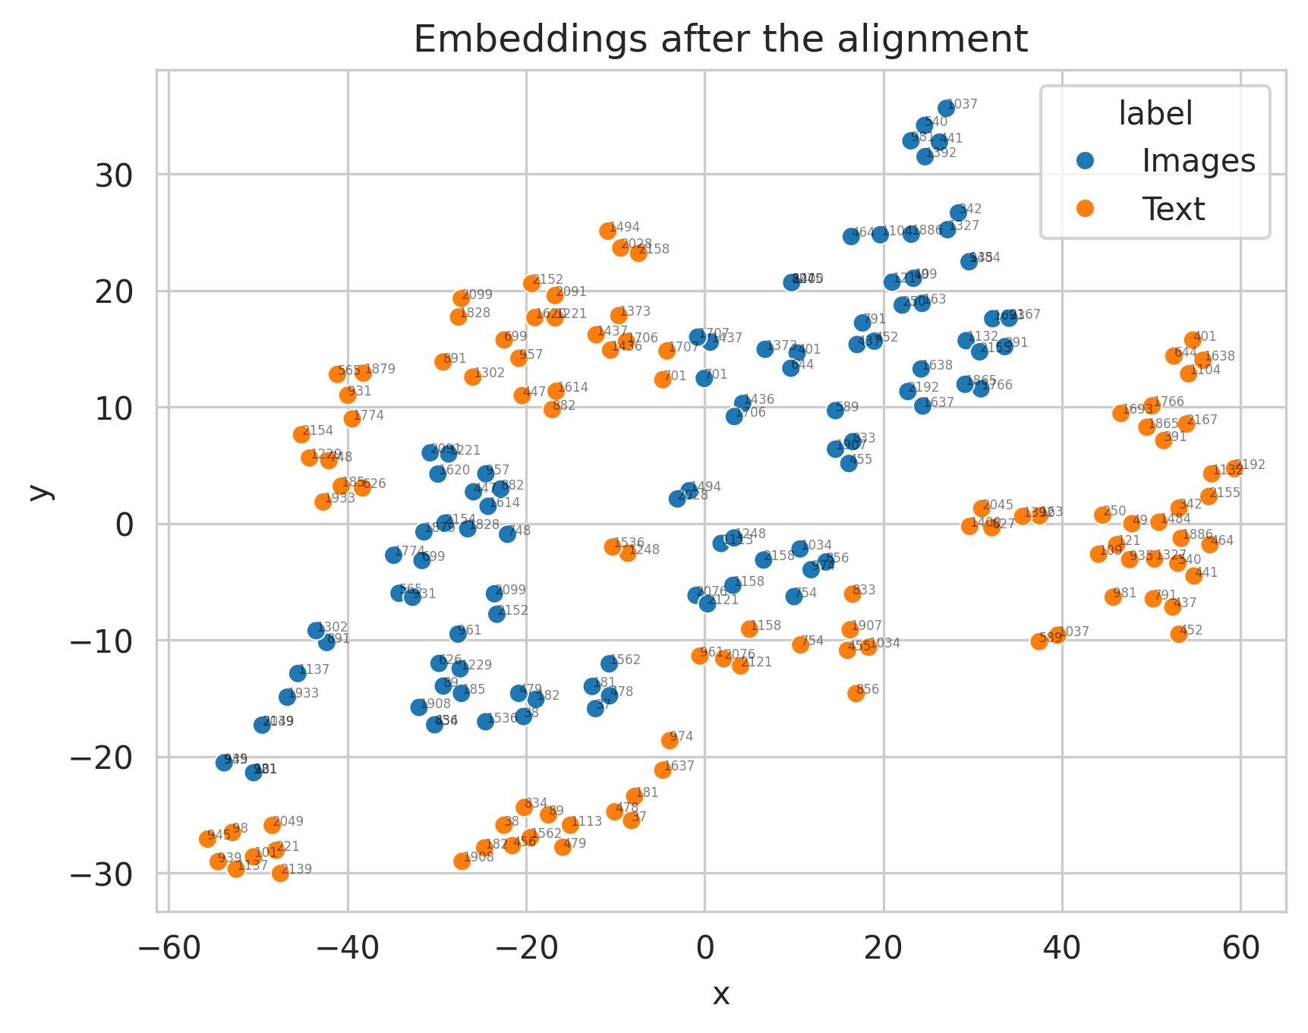
Week 4: Cross-Modal Retrieval: Using BERT
Train time: 6:45h.
Final loss value: 0.089 (vs 0.079).
Train time: 6:14h.
Final loss value: 0.091 (vs 0.075).
Image to text
Text to image

Slide 12
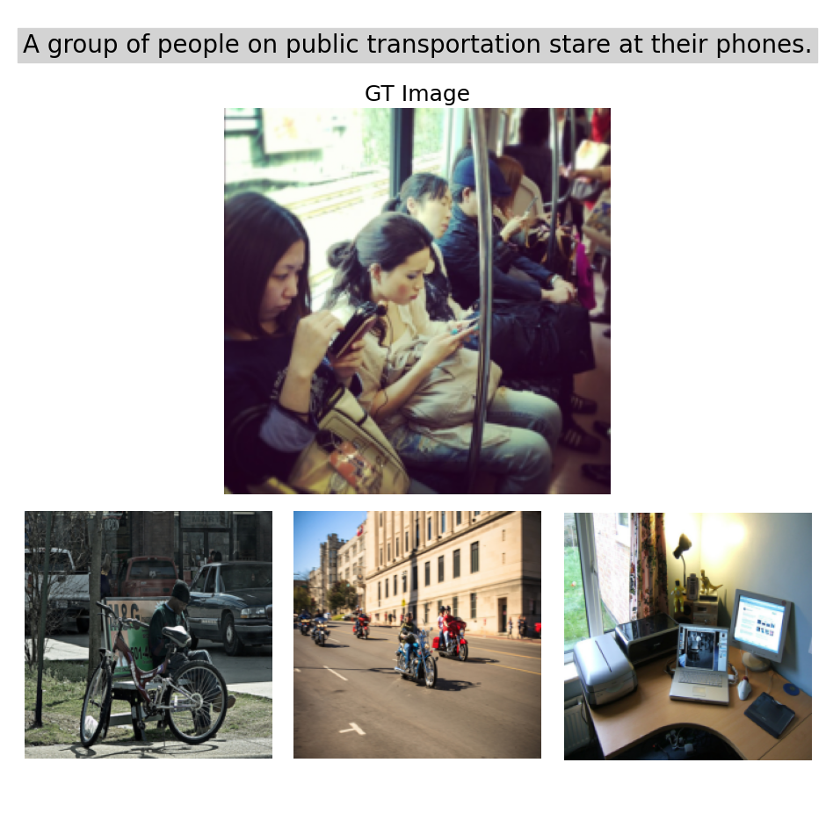
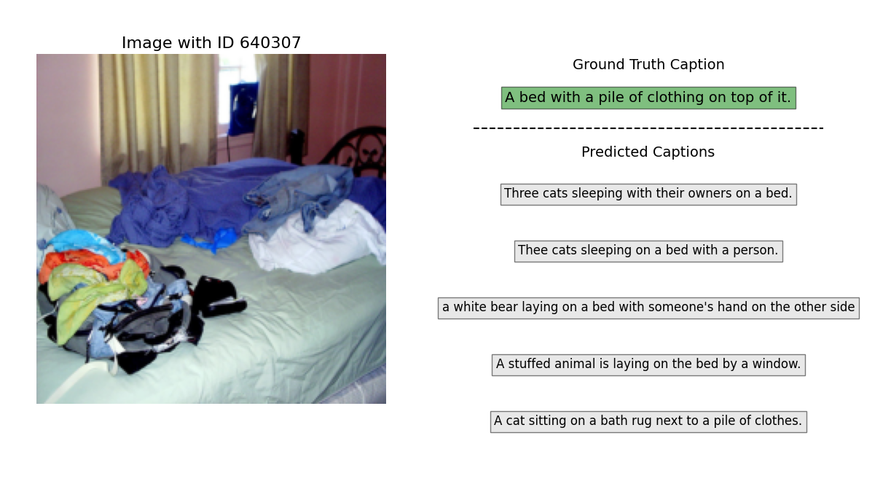
Week 4: Cross-Modal Retrieval: Using BERT

Slide 13
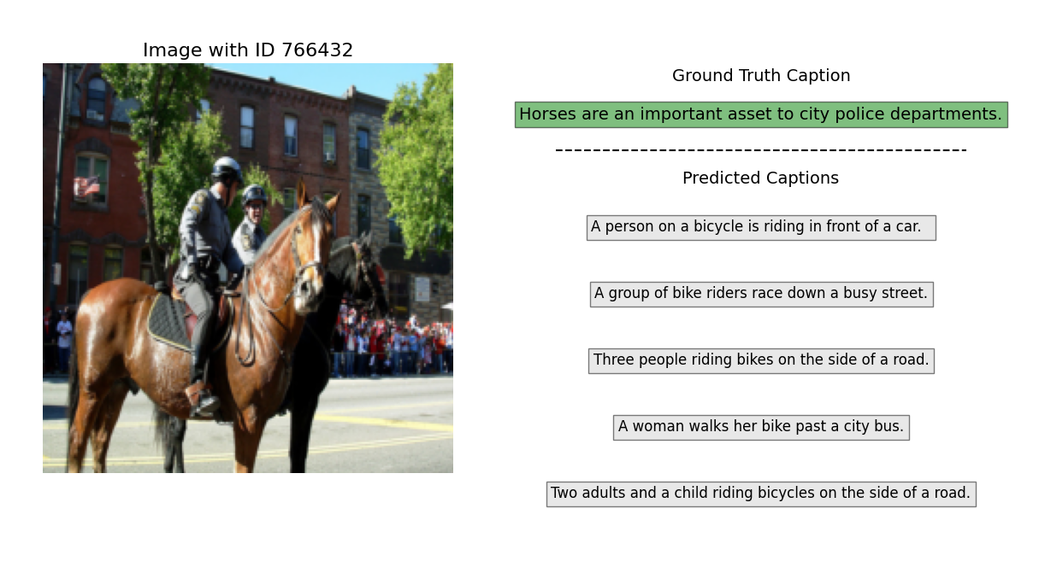








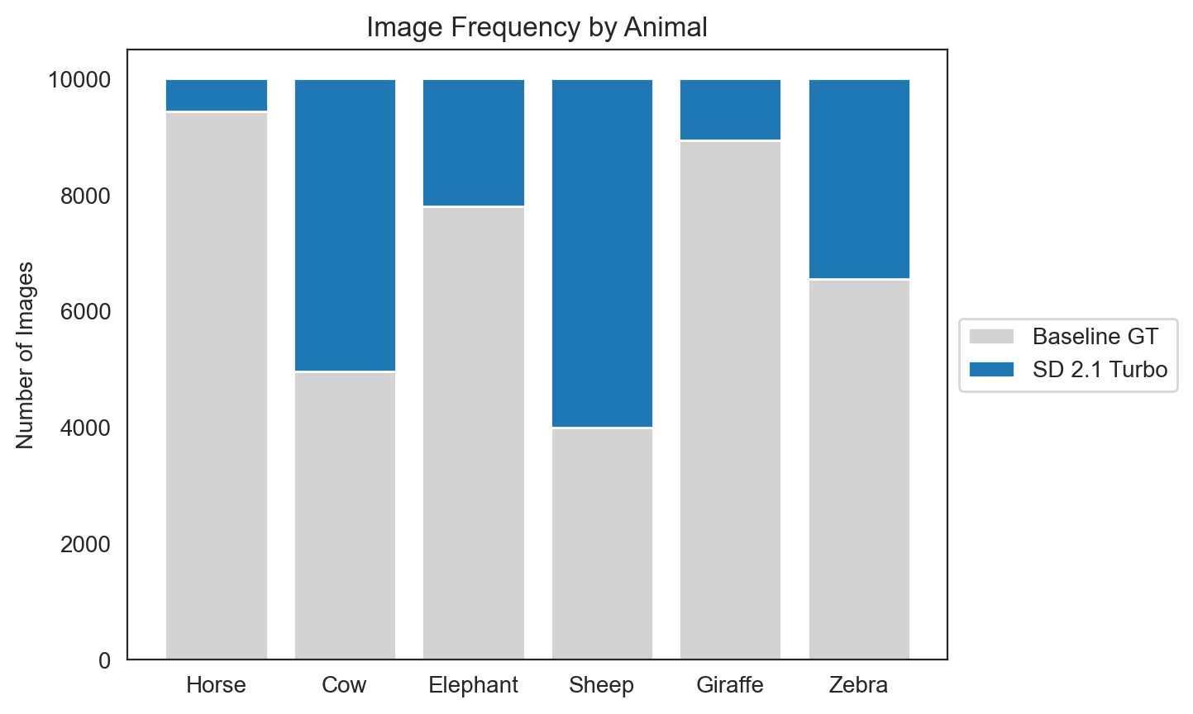
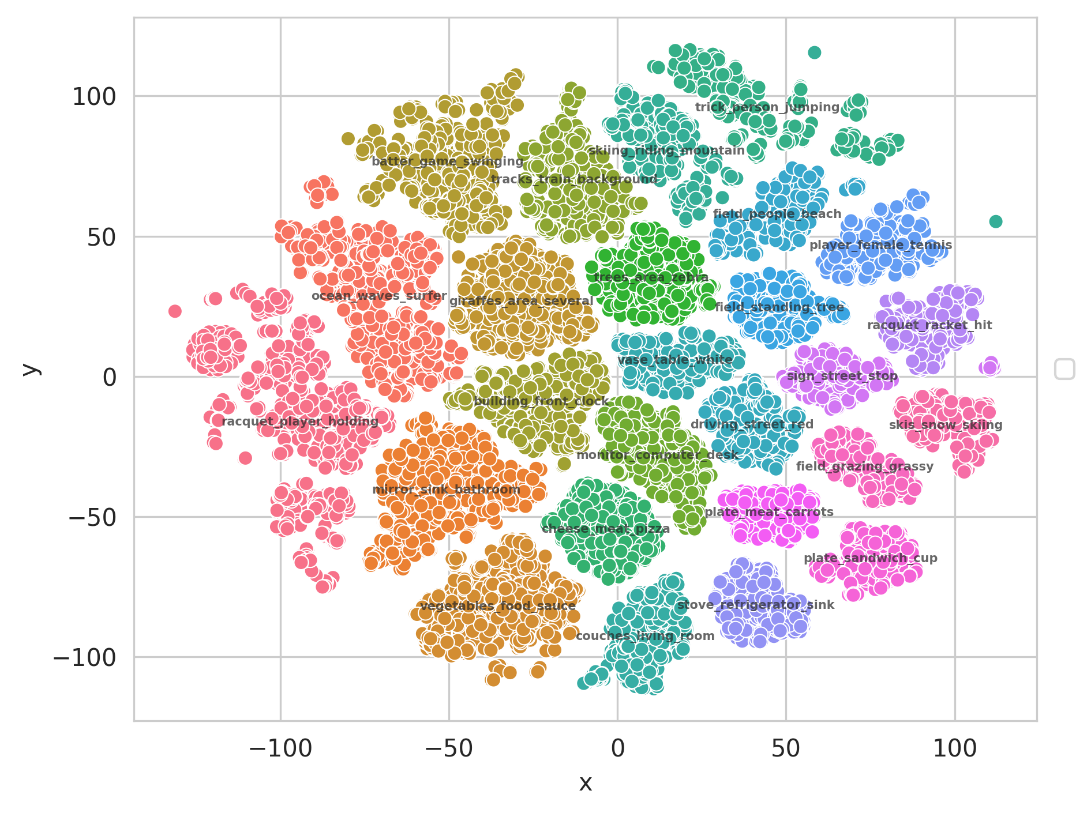

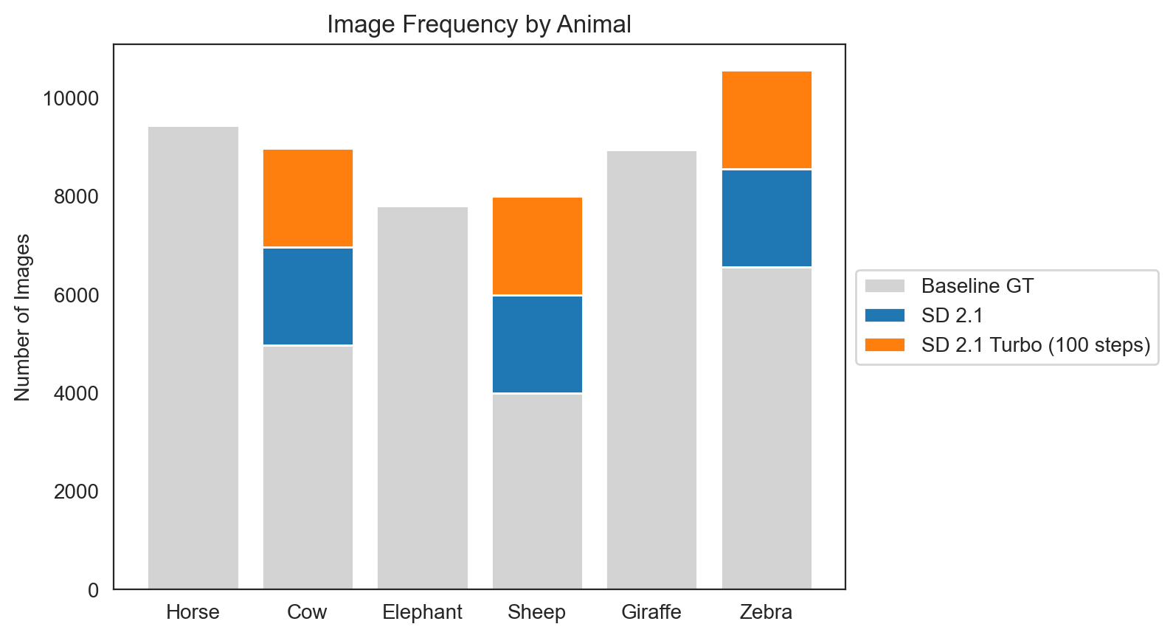
Week 5: Diffusion models
Problem: animals
SD 2.1
SD XL
SD 2.1 Turbo
SD XL Turbo
SD XL w/ 500 inference steps and DDIM
2 Different Data-Augmentation Approaches
Sentence Transformer
BERTopic
With data augmentation and fine-tuning
Notes:
In the preliminary task (a) we compared all the provided models and their corresponding turbo version. XL was clearly superior. By giving it this prompt of a “panda with glasses” we were not able to make it realistic and we guess that this could be due to the pre-training of the model in which all the pandas the model had seen with glasses were cartoonish.

Slide 14
Index
Summary of previous weeks.
Week 6: Multimodal Human Analysis
Different sets statistics
Define a classifier with image only and evaluate
Define a train strategy
Define a test strategy
Define a strategy to represent acoustic data
Define a strategy to represent text data
Multimodal model
Ablation study
Conclusions

Slide 15
Task a. Different sets statistics

Slide 16
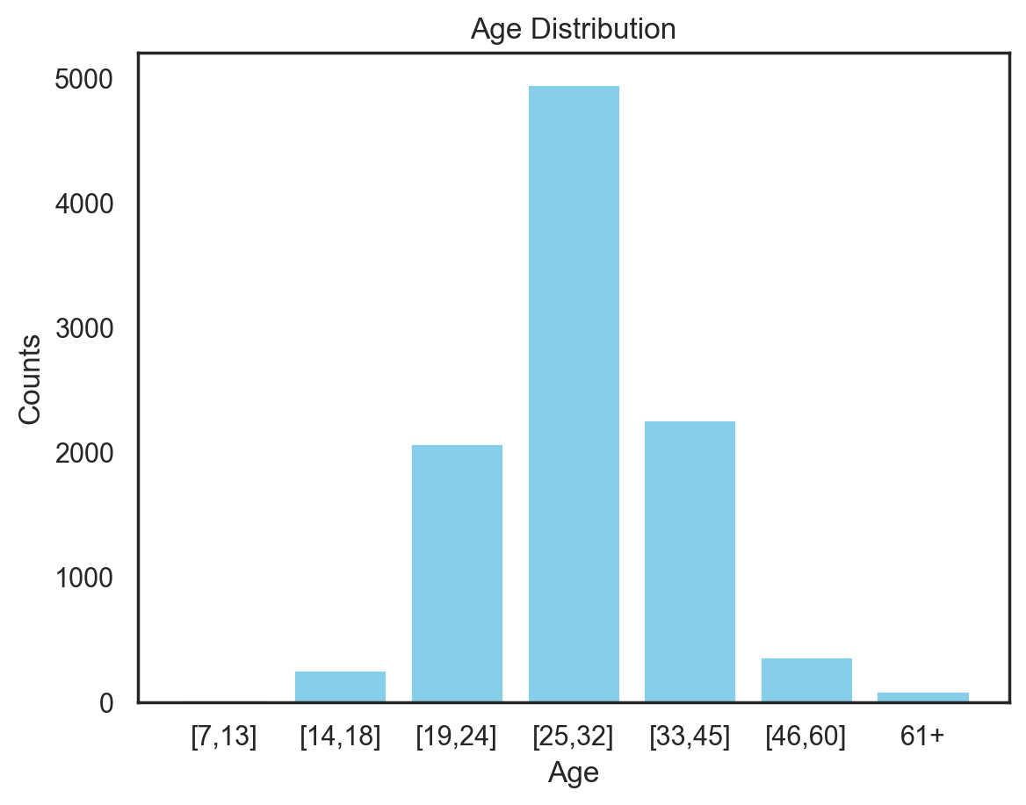
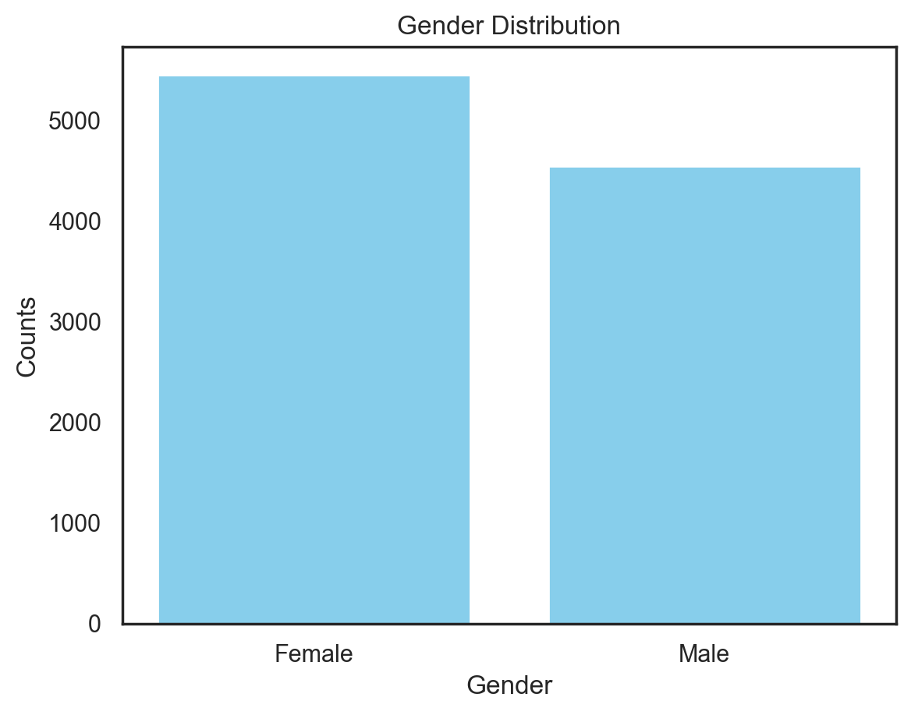

Task a. Different sets statistics
First thing we did was to create our own `DataLoader` class and take into account the full dataset without partitions to compute the Histograms for each label AgeGroup, Gender and Ethnicity.
Then we first computed the frequencies of each individual objective variable:
The age distribution seems to follow a normal distribution, by having the majority of the data centered around the central age range [25, 32]. Also, there is a huge predominance on Caucasian in the Ethnicity.
On both `train`, `val` and `test` partitions this claims we’ve just made for the fully hold.
full_dataset = ConcatDataset([train_partition, val_partition, test_partition])

Slide 17



Task a. Different sets statistics
We then computed the age distribution by our other two objective variables ‘Gender’ and ‘Ethnicity’.
Both genders follow a similar normal-like distribution. Also, they are more or less balanced, thus we do not draw any problems.
Age Distribution without Caucasian
For clarity, we plot the age distribution for the Ethnicity case without Caucasian. We can see the imbalance in age for African-American subjects.
Both genders follow a similar normal-like distribution. Also, they are more or less balanced, thus we do not draw any problems.

Slide 18
Task a. Different sets statistics
We indicate in underscore maximum of each age range, and we add the difference of each age with respect to the baseline (the ethnicity that has the maximum frequency) per each range.
We also mark in yellow those cases where there is NO representation.
Furthermore, by the observed differences we can see dangerous levels for the same age ranges of African-Americans, and for both ethnicities on [14-18] years.
Ethn. | 7–13 | 14–18 | 19–24 | 25–32 | 33–45 | 46–60 | 61+
Caucasian | 14 (+0%) | 228 (+0%) | 1885 (+0%) | 4201 (+0%) | 1854 (+0%) | 328 (+0%) | 80 (+0%)
African-A. | 5 (-64%) | 11 (-95%) | 112 (-94%) | 563 (-87%) | 345 (-81%) | 33 (-90%) | 5 (-94%)
Asian | 0 (-100%) | 15 (-93%) | 72 (-96%) | 189 (-96%) | 60 (-97%) | 0 (-100%) | 0 (-100%)
❗️
We can see how we don’t have any representation for Asian subjects of ages [7–13], [46–60] and 61+.

Slide 19
Task a. Different sets statistics
Gender / Ethn. |  | 7–13 | 14–18 | 19–24 | 25–32 | 33–45 | 46–60 | 61+
F | Caucasian | 8 (+0%) | 72 (+0%) | 919 (+0%) | 2378 (+0%) | 929 (+0%) | 149 (+0%) | 29 (+0%)
 | African-A. | 4 (-50%) | 7 (-90%) | 69 (-92%) | 390 (-84%) | 244 (-74%) | 19 (-87%) | 0 (-100%)
 | Asian | 0 (-100%) | 6 (-92%) | 49 (-95%) | 134 (-94%) | 50 (-95%) | 0 (-100%) | 0 (-100%)
M | Caucasian | 6 (+0%) | 156 (+0%) | 966 (+0%) | 1823 (+0%) | 925 (+0%) | 179 (+0%) | 51 (+0%)
 | African-A. | 1 (-83%) | 4 (-97%) | 43 (-96%) | 173 (-91%) | 101 (-89%) | 14 (-92%) | 5 (-90%)
 | Asian | 0 (-100%) | 9 (-94%) | 23 (-98%) | 55 (-97%) | 10 (-99%) | 0 (-100%) | 0 (-100%)
❗️
We can see how African-A is under-represented, and within them Male is worse represented than Female.
❗️
Asian is the worst ethnicity in terms of representation, and Male is worse represented than Female also.
Notes:
Mean bias 0.12
Caucasian bias 0.33

Slide 20
Task b. Train a classifier with image only and evaluate

Slide 21

Task b. Image only classifier
MODEL OVERVIEW
We have used the `baseline Inception Resnet V1` model given to us to do this task. The model uses pre-trained weights for the large-scale face recognition VGGFace2 dataset containing +3.3 million samples.
As pre-processing, all images are resized to a common size of 224, then several data augmentations `TrivialAugmentWide` and a normalization step for each of the images.
For training, the images are batched with a size of 256, and 300 epochs with an early stopping of 50.
For the loss, Cross-Entropy func is used to compute the logits, which are then processed through a softmax function to yield the final age predictions.

Slide 22

Task b. Image only classifier
If we monitor the loss obtained for both stages of training and testing we can see how for the loss, the model is able to converge for the training partition, however for the test set, the loss fluctuates (which is somewhat normal) but overall it increases as the training loss decreases. This is a first indicative sign of overfitting!
Overall, both the loss and the accuracies look inefficient. There is overfitting being suffered possibly memorizing some training instances that are not being translated onto testing knowledge.
Notes:
If we monitor the loss obtained for both stages of training and testing we can see how for the loss, the model is able to converge for the training partition, however for the test set, the loss fluctuates (which is somewhat normal) but overall it increases as the training loss decreases. This is a first indicative sign of overfitting!
On the other hand if we monitor the accuracy, we see that the training accuracy keeps increasing in a logarithmic manner which is a sign of healthy training, and the testing accuracy performs the same way but leading to a gap between both of them. Testing stays at 0.55~ meanwhile training keeps on going on the 0.9~ plateau.
From this we can see how monitoring the accuracy is a better idea.

Slide 23



Task b. Image only classifier
In terms of evaluation, we used the `evaluate.py` script to assess the performance of the model. This script calculates the global average accuracy as well as category-specific accuracies based on age, gender, and ethnicity. (We indicate with a dash line better than chance)
Also, we obtain a mean age bias of 0.12 which might indicate some discrepancy on the fairness of the classifications results, more precisely we obtain 0.3305 of bias for Caucasian, which is explained by the vast difference in frequencies of samples w.r.t. other ethnicities.
AGE CLASSIFICATION ACCURACIES
ACC BY GENDER
ACC BY ETHNICITIES

Slide 24
Task b. Image only classifier
Having a batch size of 256 is quite big, and it is generally recommended to always use the biggest batch size our GPU accepts as a rule of thumb. But we wanted to check how much this hyperparameters affects and we re-trained the model just by changing the batch size to 32.
What if we use a smaller batch size of 32?
DEFAULT BATCH SIZE OF 256
Epoch until stop: 145
Avg Test Accuracy: 0.5559
✅
BATCH SIZE OF 32
Epoch until stop: 77
Avg Test Accuracy: 0.2906
❌
TRAINING TIME: 1h 13min
TRAINING TIME: 37min
Thus, even though our early stop criteria triggers much faster in advance with a low batch_size, the model has not been able to generalize at all, at the cost of having a big leap in accuracy.

Slide 25
Task c. Define a train strategy

Slide 26


Task c. Define a train strategy
Analysing the task_a results, we have confirmed the big unbalance that our dataset has.
Data Augmentation
First new test set: (457 images)
Second new test set: (457 images)
Original images
Horizontal Flip
Mixed Transformation
Old train set: 6011
New train set: + 457+ 457 = 6925
Notes:
. In order to try to reduce this unbalance without reducing the number of train instances that we are using in the training, we have proposed 2 different strategies:
Data Augmentation:
In the data augmentation strategy we only create new images for the classes that have a very low number of training images compared with the other classes. These classes are: 1, 2, 6, 7.
We employ the v2.transformation from PyTorch to create new images based on the ones we already have. We create 2 sets of new train images:
The original images but with Horizontal Flip.
Images with Random Horizontal Flip + Random Rotation(-12º,12º) + Small change of brightness.

Slide 27
Task c. Define a train strategy
Analysing the task_a results, we have confirmed the big unbalance that our dataset has.
Data Augmentation
Custom Loss
Weight vector inversely proportional to the number of train images of that class.
1 ➗ ( [30, 492, 1264, 2932, 1353, 696, 153] ➗ 6925 )
[230, 14, 5, 2, 5, 10, 45]
Original images
Horizontal Flip
Mixed Transformation
Old train set: 6011
New train set: + 457+ 457 = 6925
Notes:
The problem of the Data-augmentation strategy is that is very limited due to the big difference between the amount of train images between classes (class 1: 19 images ↔ class 4: 2932 images). But on the other hand, we think that is important to use all the resources that we have to train the model since the test set has the same distribution. In an attempt of improving more our training we have applied a custom loss:
Accuracy Results:
After the implementation of the two strategies and the combination of both, we have obtained the next results:
Baseline Train Strategy (Test Acc): 0.52
New Train Strategy (Test Acc): 0.54
As we can see the results have improved a bit with this new implementation, so it would be nice to include in the next models.

Slide 28
Task c. Define a train strategy
Analysing the task_a results, we have confirmed the big unbalance that our dataset has.
Data Augmentation
Custom Loss
Weight vector inversely proportional to the number of train images of that class.
1 ➗ ( [30, 492, 1264, 2932, 1353, 696, 153] ➗ 6925 )
[230, 14, 5, 2, 5, 10, 45]
Baseline Train Strategy (Test Acc): 0.52
New Train Strategy (Test Acc): 0.54
Original images
Horizontal Flip
Mixed Transformation
Old train set: 6011
New train set: + 457+ 457 = 6925
Notes:
The problem of the Data-augmentation strategy is that is very limited due to the big difference between the amount of train images between classes (class 1: 19 images ↔ class 4: 2932 images). But on the other hand, we think that is important to use all the resources that we have to train the model since the test set has the same distribution. In an attempt of improving more our training we have applied a custom loss:
Accuracy Results:
After the implementation of the two strategies and the combination of both, we have obtained the next results:
Baseline Train Strategy (Test Acc): 0.52
New Train Strategy (Test Acc): 0.54
As we can see the results have improved a bit with this new implementation, so it would be nice to include in the next models.

Slide 29
Task d. Define a test strategy

Slide 30




Task d. Define a test strategy
Baseline strategy: treat all the images of each user individually as if they were not related to each other.
At the end, aggregate all the test images predicted results to calculate the Test Accuracy:
-9BZ8A9U7TE.000
-9BZ8A9U7TE.001
. . .
0mym1CooiTE.000
. . .
fY4tctYZTz8.004
Pred Label: 3
Gt Label: 1
Pred Label: 1
Gt Label: 1
Pred Label: 3
Gt Label: 3
Pred Label: 4
Gt Label: 7
[0,1,·······,1,·······,0]
One-hot vector:
True=1
False=0
Test Accuracy: 0.523

Slide 31

Task d. Define a test strategy
Aggregate results of the user to avoid false predictions.
We added the probabilities of the same user and kept the highest one.
-9BZ8A9U7TE.000
-9BZ8A9U7TE.001
-9BZ8A9U7TE.002
. . .
0mym1CooiTE.000
. . .
fY4tctYZTz8.004
[0.05, 0.10, 0.21, 0.35, 0.12, 0.08, 0.05]
[0.45, 0.10, 0.11, 0.15, 0.02, 0.08, 0.05]
[0.35, 0.05, 0.21, 0.25, 0.12, 0.03, 0.05]
Pred Label: 3
Gt Label: 3
Pred Label: 4
Gt Label: 7
Pred Label: 1
Gt Label: 1
[0.85, 0.25, 0.43, 0.75, 0.26, 0.19, 0.15]
[1,·······,1,·······,0]
Not much change in the results, so maybe the model was already providing the same predicted label for different images of the same user.
Test Accuracy: 0.518

Slide 32
Task e. Define a strategy to represent acoustic data

Slide 33




Task e. Define a strategy to represent acoustic data
Used Librosa to extract audio information.
‘Normalization’ by dividing the original values by 2^15-1 (because we have 16bit audios):
Better way of working with the data, since the saved volume may be different depending on the used device.
Plot computed using ‘wavfile’
Plot computed using ‘Librosa’

Slide 34

Task e. Define a strategy to represent acoustic data
Extracted information:
Preprocessing steps are necessary:
Number of words in the audio.
Number of words per second.
Tempo
Fundamental frequency:
DENOISING: Performed using the Noisereduce library.
TRIMMING:
Not implemented, because we consider that the pause or the urge before starting to talk is a
characteristic of the age of the speaker.
- Mean
- Median
- Standard deviation
- 5-percentile
- 95-percentile

Slide 35


Task e. Define a strategy to represent acoustic data
By finding the onset we compute the number of spoken words per second.
With some exceptions, but we expect younger people to have higher values of number of words per second and beats per minute.
Age class: 6 → 46-60 years
Audio length: 15.302s
Number of words/s: 3.20
Beats per minute (bpm): 18.38
Age class: 2 → 14-18 years
Audio length: 15.302s
Number of words/s: 3.46
Beats per minute (bpm): 21.31

Slide 36



Task e. Define a strategy to represent acoustic data
Fundamental frequency: Lowest frequency at which a periodic sound appears (pitch).
Age class: 1 → 7-13 years
f0 mean: 443.26
f0 median: 292.60
f0 standard deviation: 544.91
f0 5-percentile: 102.56
f0 95-percentile: 1145.30
Age class: 4 → 25-32 years
f0 mean: 971.51
f0 median: 151.46
f0 standard deviation: 1242.97
f0 5-percentile: 89.64
f0 95-percentile: 3993.93
Age class: 7 → 61+ years
f0 mean: 154.15
f0 median: 145.46
f0 standard deviation: 39.86
f0 5-percentile: 104.68
f0 95-percentile: 233.51

Slide 37
Task e. Define a strategy to represent acoustic data
Audio pipeline scheme:
The number of words in the audio depends on the sentence itself, it is a characteristic of the text, not from the speaker.
1st step: Preprocess data:
- Divide data by 2^15
- Noise reduction
2nd step: Extract features:
- # words in the audio
- # words per second
- # beats per minute
- Fundamental frequency:
- Mean
- Median
- Standard Deviation
- 5-percentile
- 95-percentile
Classification model
Predicted Label

Slide 38
Task f. Define a strategy to represent text data

Slide 39



Task f. Define a strategy to represent text data
As a textual encoder to extract features from text, we’ve used BERT from the HuggingFace transformer’s library. Afterwards we added 2 non-linear layers at the top with ReLU activations.

Slide 40



Task f. Define a strategy to represent text data
Train TSNE
Val TSNE
Test TSNE
All classes spreaded out. But, for some very specific age intervals, such as old or very young people (classes 1→ [7, 13], 6 → [46, 60], 7 → 61+), their embeddings are generally more concentrated in specific locations.
So, we consider important for just some specific age intervals.

Slide 41
Task g. Multimodal model

Slide 42


Task g. Multimodal model
STRATEGY: Late fusion. We have trained each model separately and combined them afterwards.
Input Data
Image
Final prediction
Tasks b) & c)
Audio
Task e)
Audio features
Audio classif model
Aggregation
Caption
"Now or if I didn't get to answer it, I just didn't want the video to be too long. I'm already conscious that it's gone on for way too long. I will do another one of these in the future, so don't feel like you've missed out.
Task d)
Task f)

Slide 43

Task g. Multimodal model
Image Classification Model:
Loss: Weighted Cross Entropy Optimizer: AdamW
Learning Rate: 1e-6
Batch Size: 256
Image model Test Accuracy: 0.54
Notes:
We have used the same model as in the task b, but this time with the new train implementation of the task c (data-augmentation + weighted loss). The model is an Inception ResNet model pre-trained on VGG-Face2. For the loss, weighted Cross-Entropy func is used to compute the logits, which are then processed through a softmax function to yield the final age predictions. The weights for each class are inversely proportional to the number of train images of each class.

Slide 44
Task g. Multimodal model
TIME COMPARISON:
- Before new strategy:
~18s per audio,
~31 hours per epoch
- After new strategy:
~2.4s per audio,
~16 minutes per (reduced) epoch
Audio Classification Model:
Loss: Weighted Cross Entropy Optimizer: AdamW
Learning Rate: 1e-6
Batch Size: 32
- # words per second
- # beats per minute
- Fundamental frequency:
- Mean
- Median
- Standard Deviation
- 5-percentile
- 95-percentile
Dense Layer 7 → 16
Batch Normalization
Dense Layer 16 → 32
Dropout (p=0.4)
Batch Normalization
Dropout (p=0.4)
ReLU
ReLU
Batch Normalization
Dense Layer 32 → 16
Softmax
Batch Normalization
Dropout (p=0.4)
Dense Layer 16 → 7
ReLU
Notes:
In this case we are not working with images, and neither with an embedding. We just have 7 values to work with for every audio, the ones extracted in task e). So, a quite simple linear model was created to classify the extracted features into age-ranges:

Slide 45


Task g. Multimodal model
TIME COMPARISON:
- Before new strategy:
~18s per audio,
~31 hours per epoch
- After new strategy:
~2.4s per audio,
~16 minutes per (reduced) epoch
Audio Classification Model:
Loss: Weighted Cross Entropy Optimizer: AdamW
Learning Rate: 1e-6
Batch Size: 32
- # words per second
- # beats per minute
- Fundamental frequency:
- Mean
- Median
- Standard Deviation
- 5-percentile
- 95-percentile
Audio model
test accuracy:
49.37%
Dense Layer 7 → 16
Batch Normalization
Dense Layer 16 → 32
Dropout (p=0.4)
Batch Normalization
Dropout (p=0.4)
ReLU
ReLU
Batch Normalization
Dense Layer 32 → 16
Softmax
Batch Normalization
Dropout (p=0.4)
Dense Layer 16 → 7
ReLU
Notes:
It can be seen how there is still some room for improvement for the audio model, even though it is not a lot, given that the validation accuracy is stuck.
But, since we did not have time, we have retrieved the checkpoint with the lowest validation loss.
The observed validation accuracy is higher than the train accuracy. This reflects the fact that the model generalizes correctly, and, from our perspective, with more time we could use the entire training set on each training epoch (instead of a random third part in each epoch), and so the model would be able to further improve its accuracy and loss (at least in the training set).

Slide 46


Task g. Multimodal model
Loss: Weighted Cross Entropy Optimizer: AdamW
Learning Rate: 1e-6
Batch Size: 256
Text Classification Model:
"Now or if I didn't get to answer it, I just didn't want the video to be too long. I'm already conscious that it's gone on for way too long. I will do another one of these in the future, so don't feel like you've missed out.
BERT Model
Text model Test Accuracy: 0.49
ReLU Activation
Linear 1 (768,512)
Linear 2 (512,7)
Notes:
As we have explained in task f, we have employed BERT in order to extract the deep text features of the user’s transcriptions. Once we have the BERT’s tokenizers we have created a very simply model composed by a 2 Linear layers and a ReLU activation function to obtain the label predictions:.
After training we can analyze a bit their accuracy and loss curves. The validation and training values are very similar so there is a limitation in the characteristics of the text data that prevents the model from learning to differentiate ages with only text. The maximum accuracy obtained is near 0.5, that is quite good if we take into a account that there are 7 different classes, and we are only using text features. Moreover, the accuracy stagnates around the epoch 15, but the loss continues to improve.

Slide 47
Task g. Multimodal model
Combining Models:
Logits Aggregation
With the combination of predictions we have obtained an improved solution in terms of Test Accuracy. We have outscored the results of task b only using images, so we can confirm that the use of different data types in a multimodal model is a way of improve our classification model.
Image
Audio
SoftMax
Predicted Age
Caption
"Now or if I didn't get to answer it, I just didn't want the video to be too long. I'm already conscious that it's gone on for way too long. I will do another one of these in the future, so don't feel like you've missed out.
Image Test Accuracy: 0.535
Audio Test Accuracy: 0.49
Text Test Accuracy: 0.49
COMBINED TESTING ACCURACY: 0.55
Notes:
Once the three models have been trained and saved their weights, we create a new inference model that combines the three predictions of the same VideoName to obtain a final and improved prediction.

Slide 48
Task h. Ablation Study

Slide 49
Task h. Ablation Study
Weighted Sum
Image
1.2
SoftMax
Predicted Age
Audio
0.8
The use of the weighted sum has not improved the final results a lot (~0.001). Maybe, the weight difference is very low to have an impact in the results or maybe the performance of the model has reached its limit and it is impossible to improve more the test accuracy.
Caption
"Now or if I didn't get to answer it, I just didn't want the video to be too long. I'm already conscious that it's gone on for way too long. I will do another one of these in the future, so don't feel like you've missed out.
0.8
TESTING ACCURACY: 0.55
Notes:
In order to know which type of data has more importance in the final result we can combine the different model solutions with a weighted sum, giving different weights to each data type result. In the previous task we have seen how the image model outscored the other models, so we propose to give a higher weight to the image results than to the others:

Slide 50
Task h. Ablation Study
Weighted Sum
Image
1.2
SoftMax
Predicted Age
Audio
After proving this new method the results are a bit lower than the previous one using the text. So, the text does have a positive influence on the results and it is important to include it in the multimodal model implementation.
0.8
Caption
❌
"Now or if I didn't get to answer it, I just didn't want the video to be too long. I'm already conscious that it's gone on for way too long. I will do another one of these in the future, so don't feel like you've missed out.
0
TESTING ACCURACY: 0.54
Notes:
We think that the use of text in an age classification problem is a very hard task and it is very difficult to know the age of a person only using the words that he/she uses in a 15 seg video. So we are going to run the combined inference model, but this time only using image and audio, to know if the text has importance in this task or only is introducing noise.

Slide 51
Task h. Ablation Study
Weighted Sum
Image
1.2
SoftMax
Predicted Age
❌
Audio
Again, the combination of only two data types gives us lower results than the full combination. In this case the results are a bit lower than only image + audio, so the importance of the audio data is higher than the text, confirming what we expected.
0
Caption
"Now or if I didn't get to answer it, I just didn't want the video to be too long. I'm already conscious that it's gone on for way too long. I will do another one of these in the future, so don't feel like you've missed out.
0.8
TESTING ACCURACY: 0.54
Notes:
After proving only the combination of image + audio and obtaining lower results, we have to try the multimodal model but without audio (image + text). Using this combination we can check the importance or not of the audio in this classification task.

Slide 52
Task i. Conclusions

Slide 53
Task i. Conclusions
The unbalance of the dataset is a big problem in order to obtain better results. We have tried to reduce the negative effect through data-augmentation but the extremely difference between the number of some classes prevents us from obtaining higher results.
The combination of different data sources in the multimodal model provides us an improvement in the final accuracy results. Moreover after the ablation study we have confirmed the importance of using the three data types, and the higher importance of audio over text.
Finally, our late fusion model is very limited by the individual model results, so in future implementations we should combinate the different data before training an unique model.

